Slide 1

The Human Genome and Variation III Determining pathogenic variants
授课老师：陈靖祺 副研究员
复旦大学类脑智能科学与研究院
2024年秋季学期

Slide 2
Review: genomic variation
Large
Small
Chromosomal abnormalities: e.g. trisomy; 45,X
Structural variation: e.g. deletion, duplication, translocation of a relatively long sequence
Base-level variation: SNP and InDels
These can be precisely detected through sequencing

Slide 3
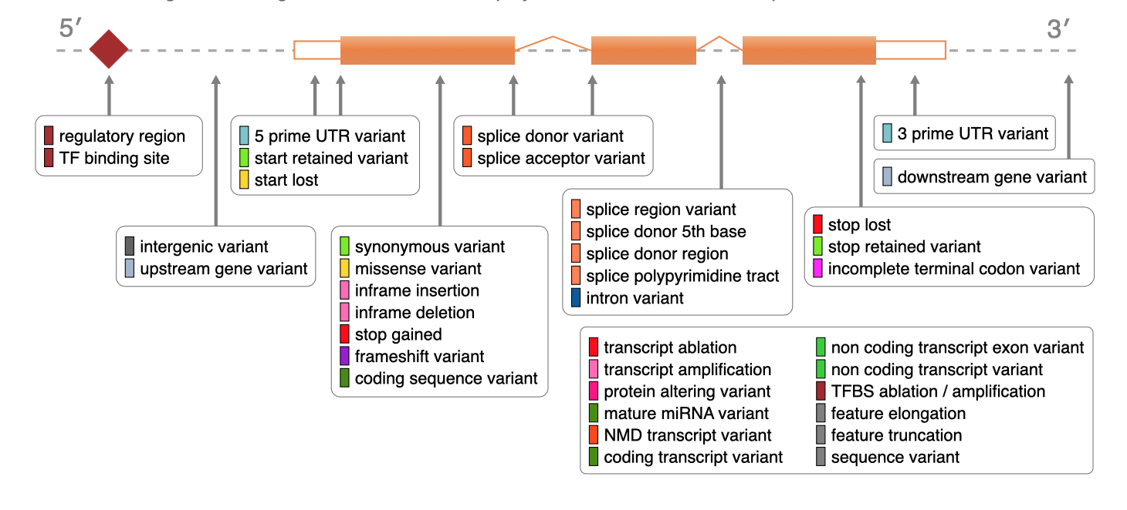
Review: the consequence of SNPs/InDels
Possible consequences of SNPs/InDels
Relative to a protein-coding gene:
Outside of protein-coding genes:
Affect regulatory elements -> affect gene regulation
Affect noncoding RNAs, etc.
http://mart.ensembl.org/info/genome/variation/prediction/predicted_data.html

Slide 4
Review: the consequence of SVs
Consequences of SV
Relative to a coding gene:
Possibly more severe impact than SNP due to the size
Outside of coding genes:
impact regulatory elements (figure to the right)
Impact ncRNAs
Legend：
Regulatory
elements
gene
regulation
TAD boundary
(a)
(b)
(c)
Deletion
Deletion
Duplication
(d)
(e)
(f)
Insertion
(of a long sequence)
Insertion of a new regulatory element
Insertion
(g)
(h)
1
2
1
Inversion
Translocation
1
1
2
2

Slide 5
Benign variants Vs. Pathogenic variants
Where can we find established pathogenic variants? Are there a collection of known pathogenic variants?

Slide 6
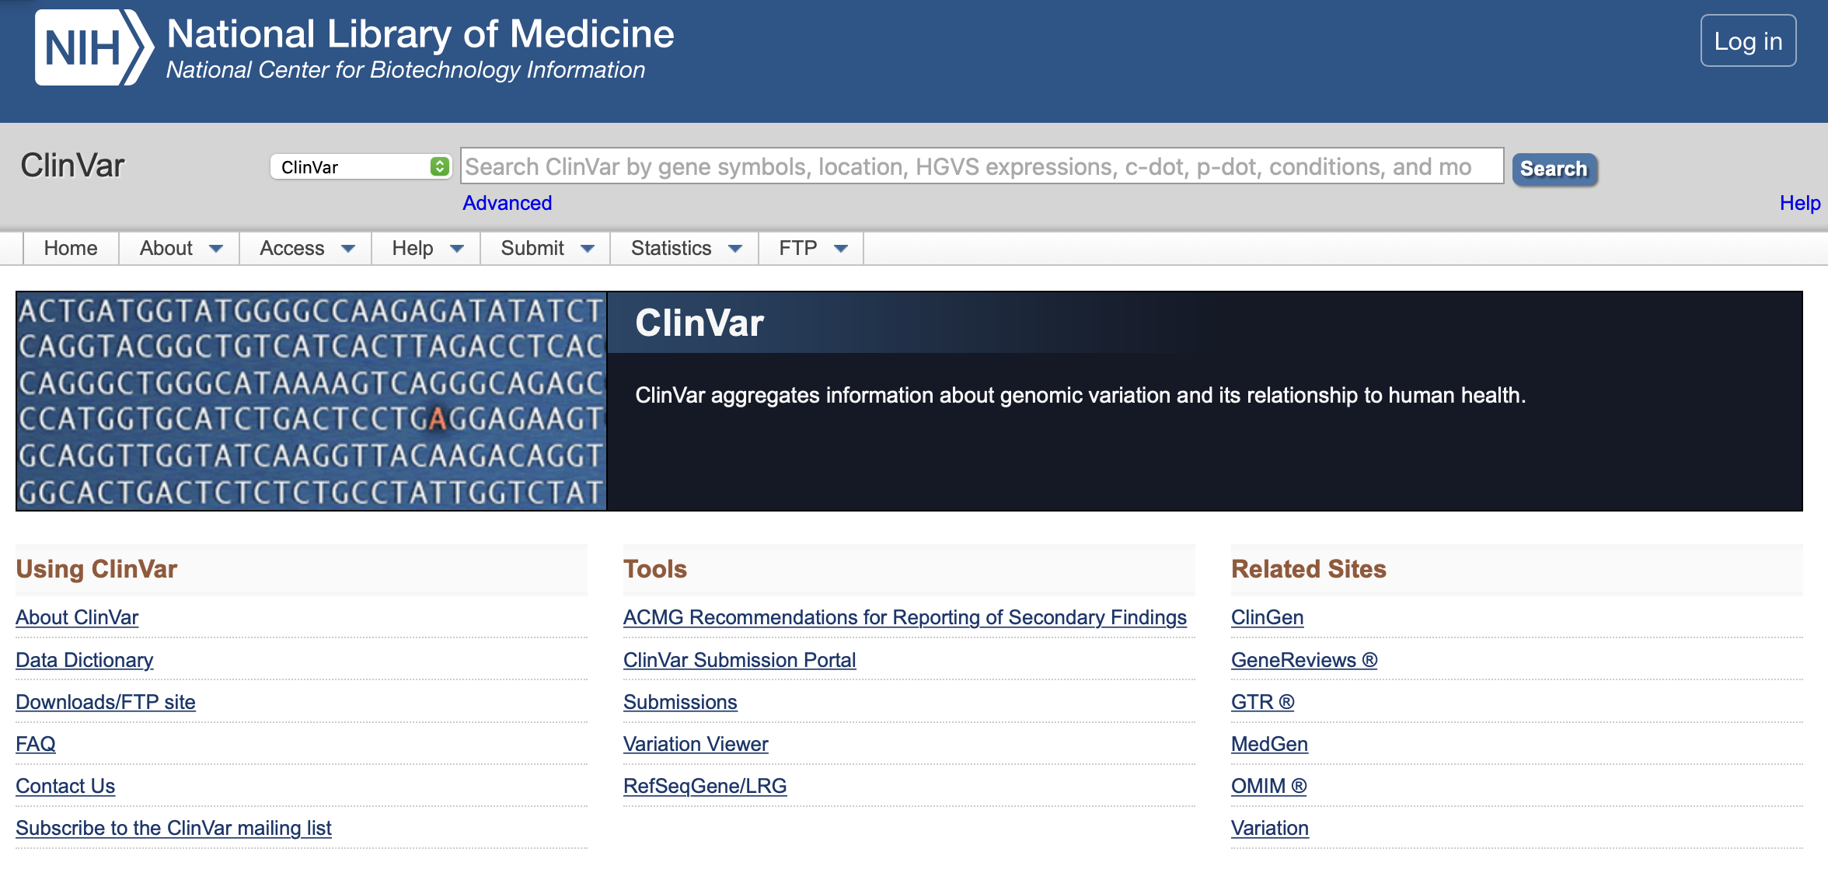
Benign variants Vs. Pathogenic variants
ClinVAR
ClinVar is a freely accessible, public archive of reports of human variations classified for diseases and drug responses, with supporting evidence.
https://www.ncbi.nlm.nih.gov/clinvar/

Slide 7
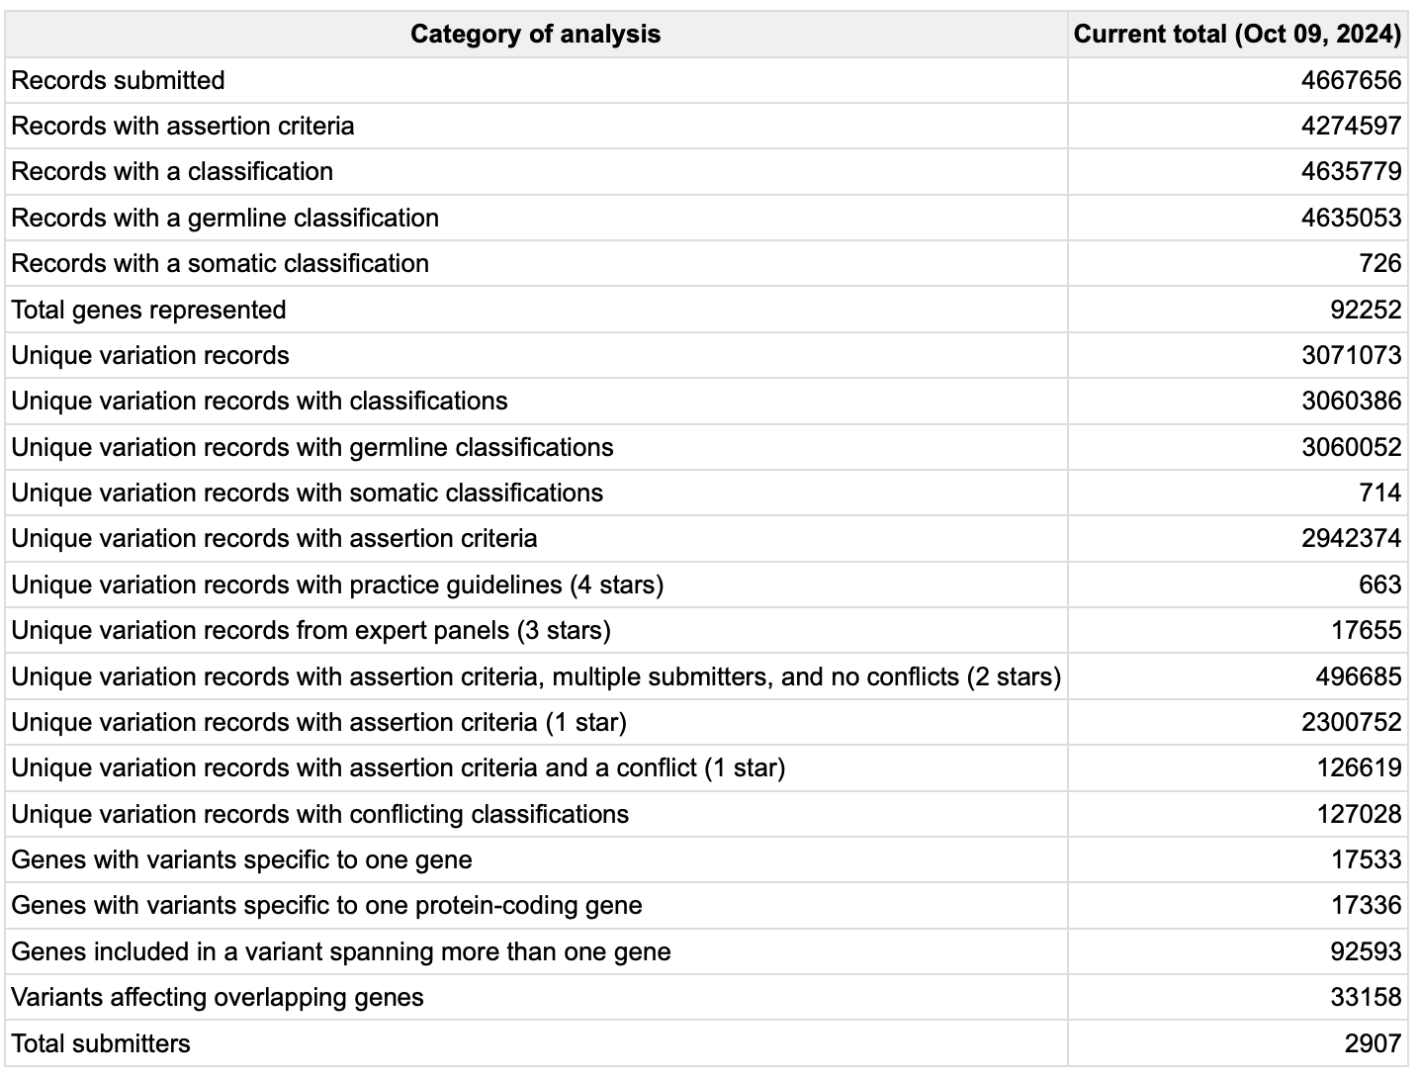
Benign variants Vs. Pathogenic variants
ClinVAR
https://www.ncbi.nlm.nih.gov/clinvar/

Slide 8
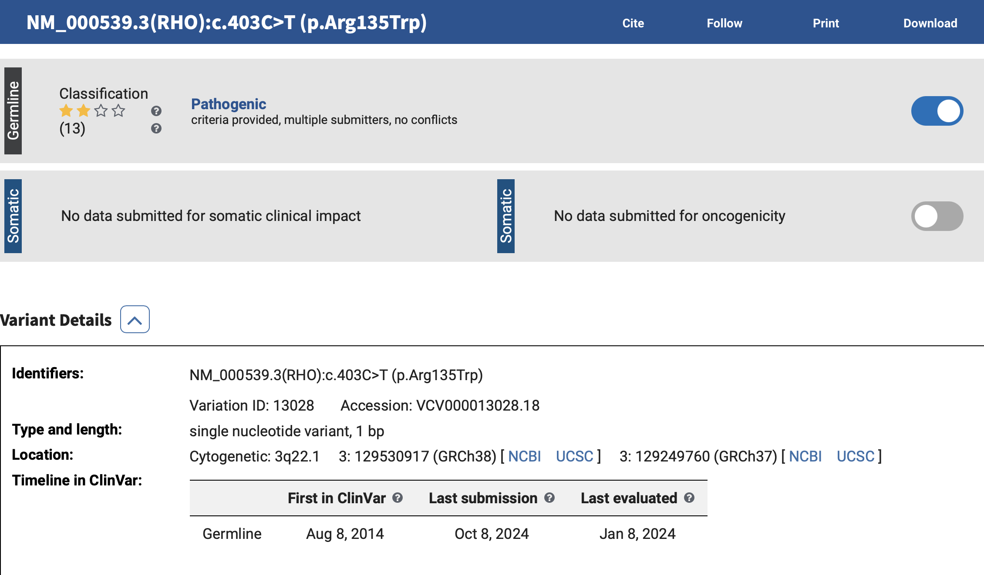
Benign variants Vs. Pathogenic variants
ClinVAR: missense SNP rs104893775
https://www.ncbi.nlm.nih.gov/clinvar/variation/13028/

Slide 9
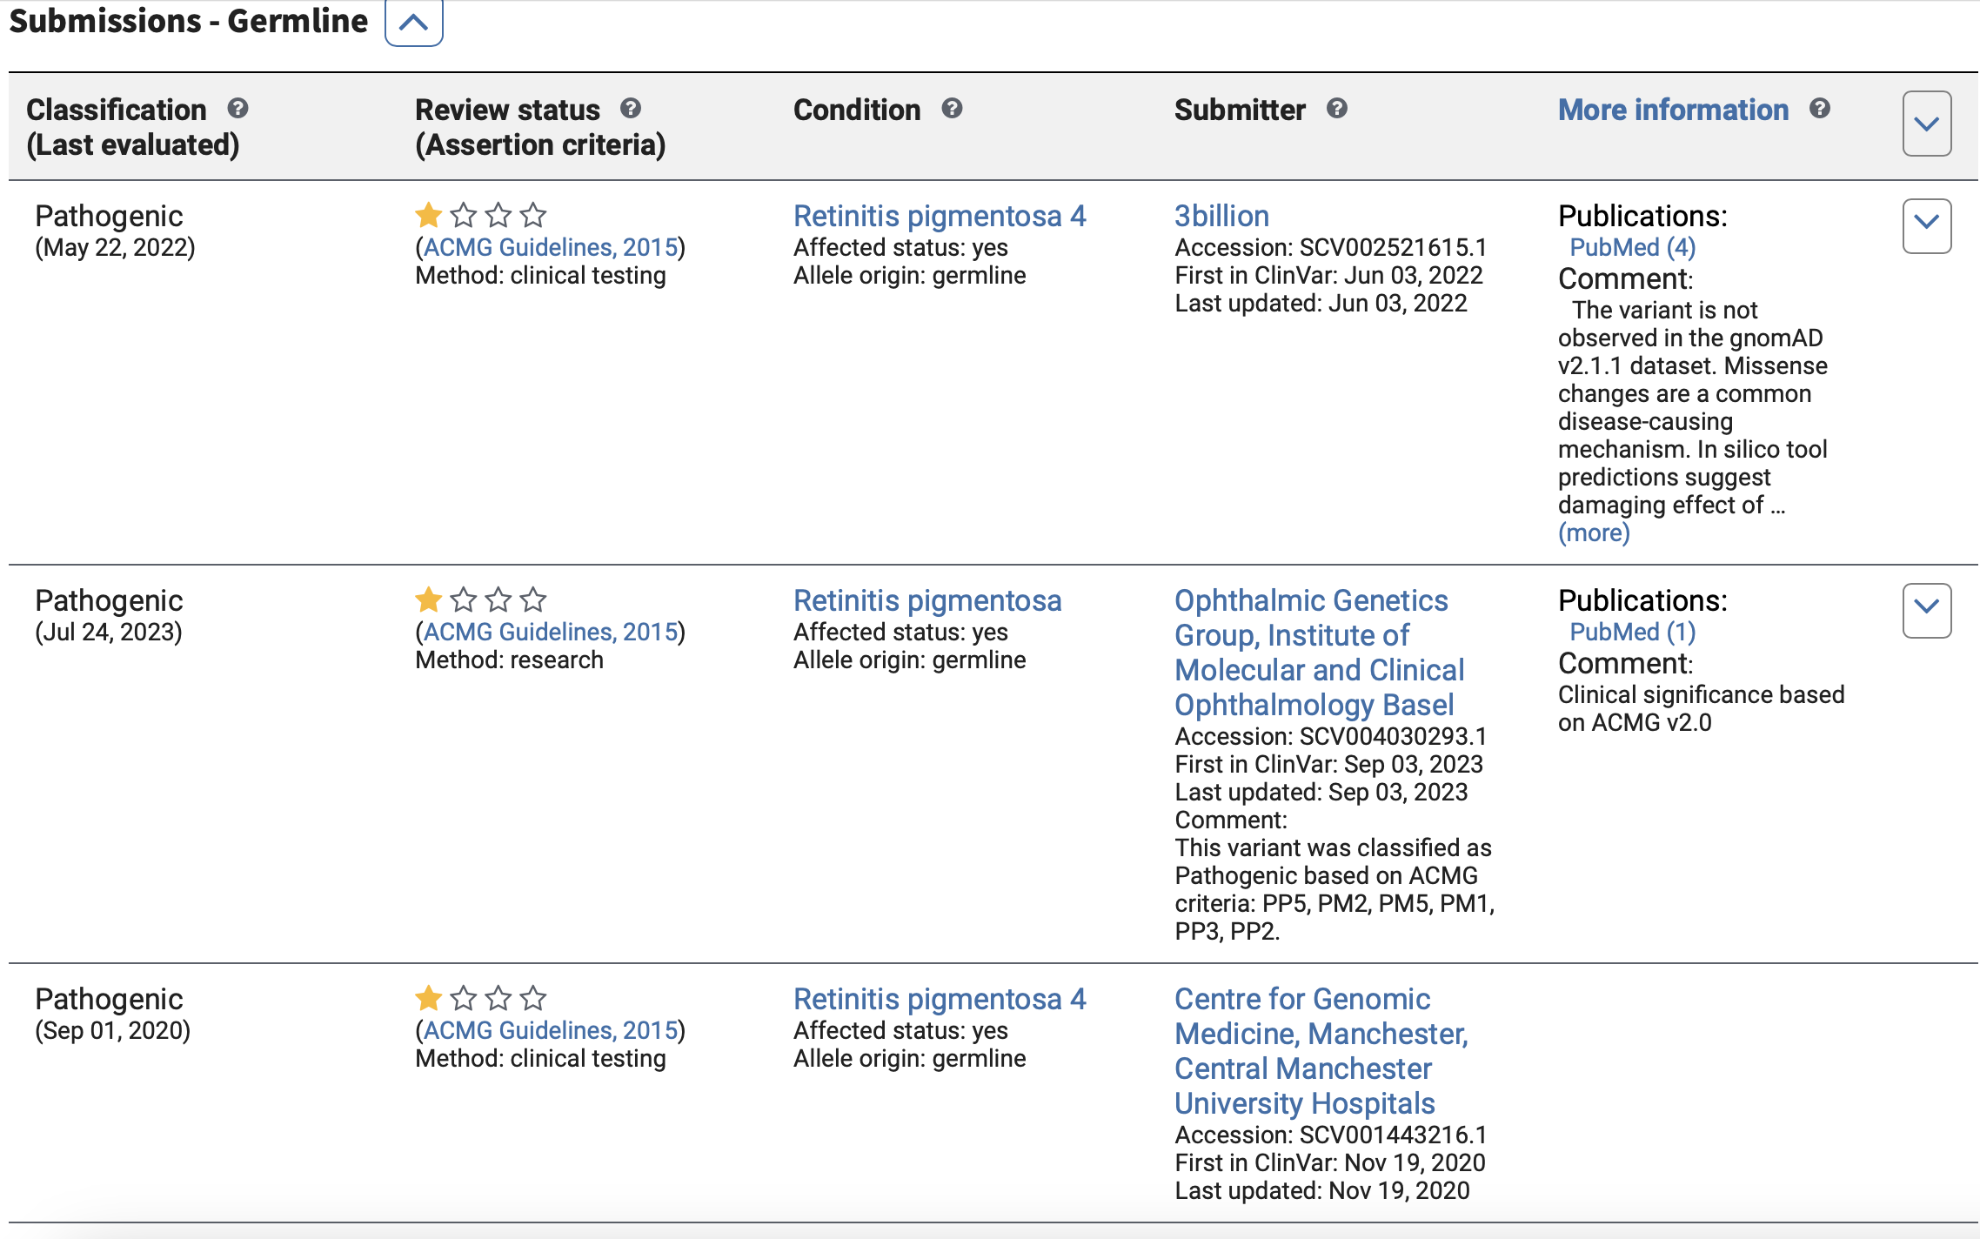
Benign variants Vs. Pathogenic variants
ClinVAR: missense SNP rs104893775
https://www.ncbi.nlm.nih.gov/clinvar/variation/13028/

Slide 10
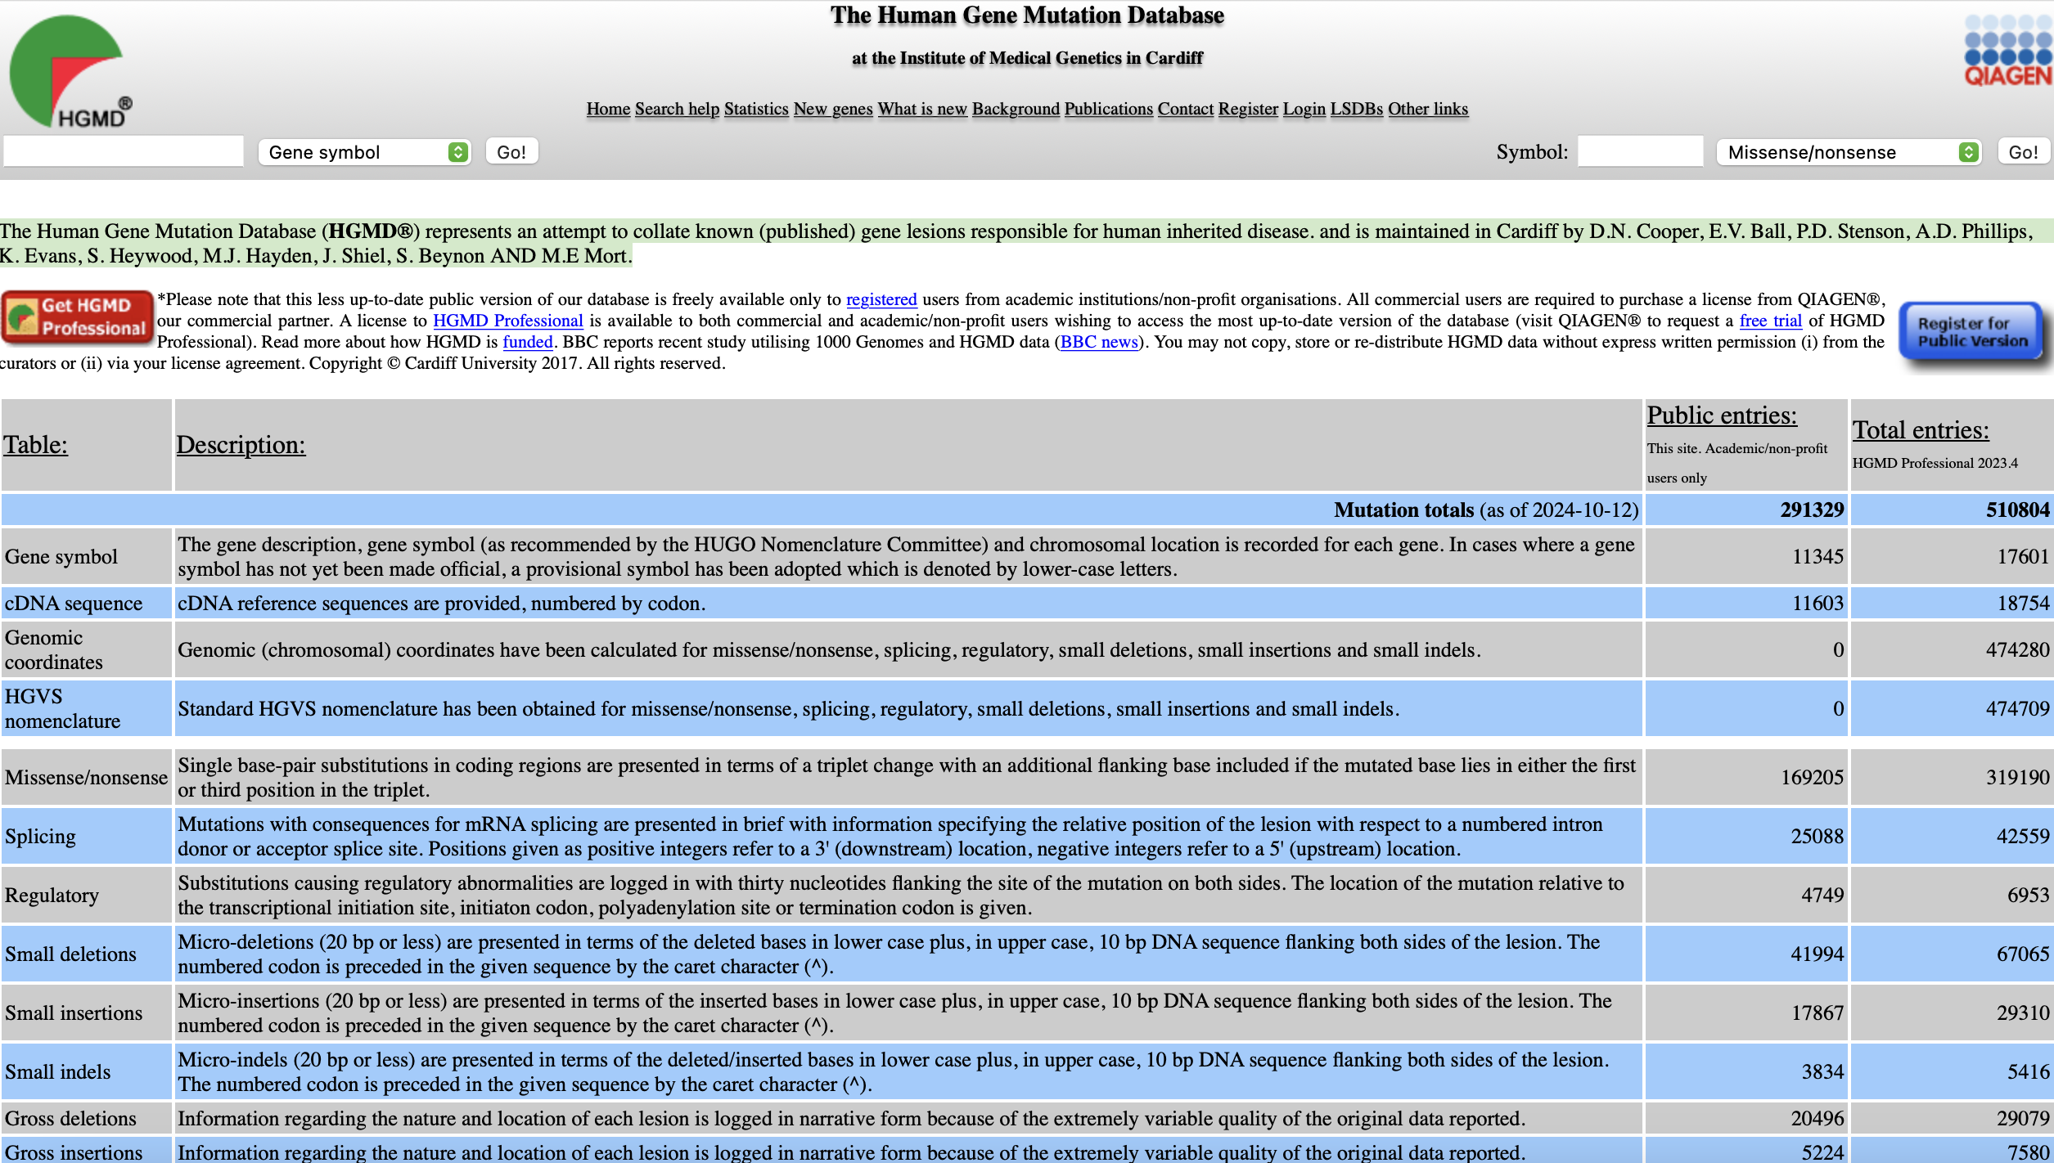
Benign variants Vs. Pathogenic variants
HGMD (The Human Gene Mutation Database)
The Human Gene Mutation Database (HGMD®) represents an attempt to collate known (published) gene lesions responsible for human inherited disease.
https://www.hgmd.cf.ac.uk/ac/index.php

Slide 11
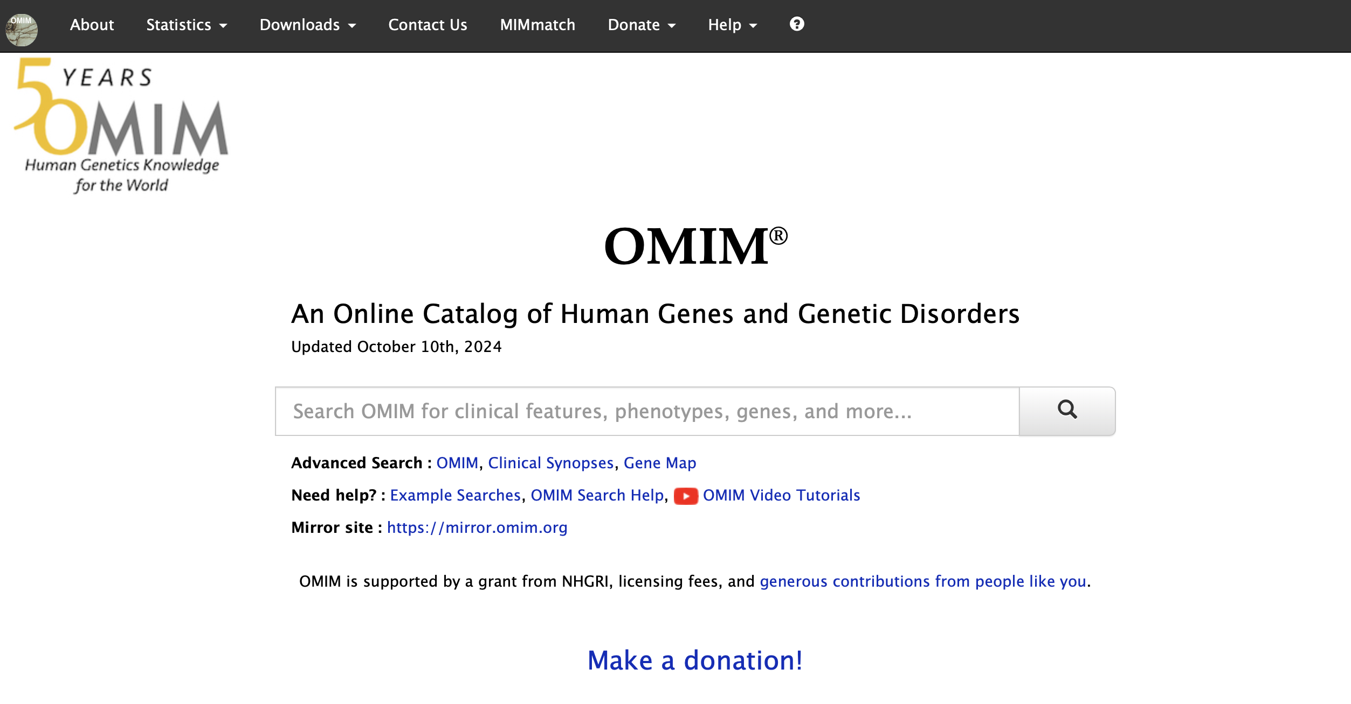
Benign variants Vs. Pathogenic variants
OMIM (Online Mendelian Inheritance in Man): focusing more on genes/disorders, while referring to variants
https://omim.org

Slide 12
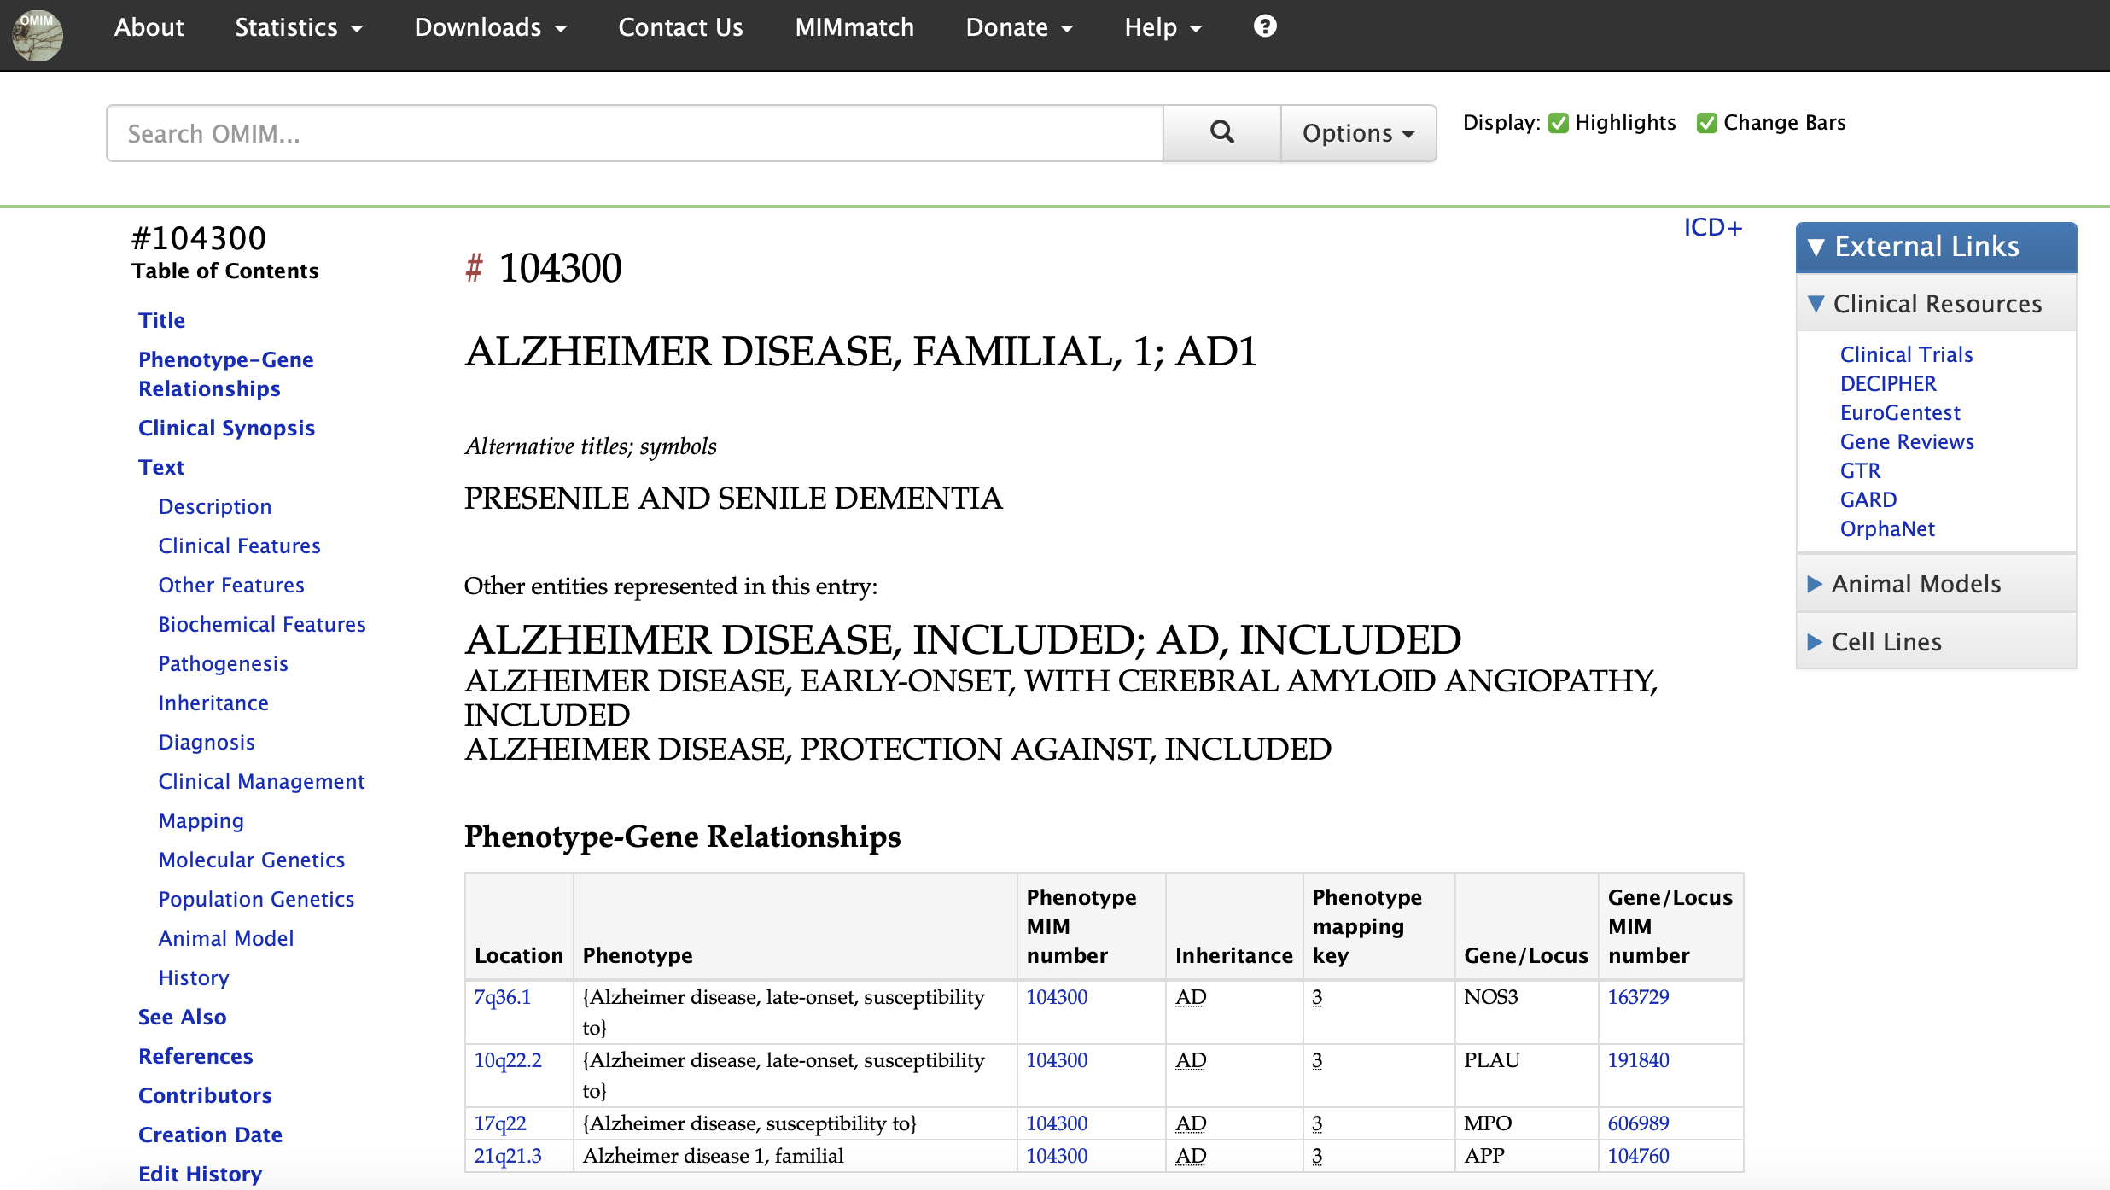
Benign variants Vs. Pathogenic variants
OMIM (Online Mendelian Inheritance in Man)
https://omim.org/entry/104300?search=apoe&highlight=apoe

Slide 13
Benign variants Vs. Pathogenic variants
Are these “pathogenic” variants really or always pathogenic? In other words, do carriers of these variants always have the disease(s)?

Slide 14
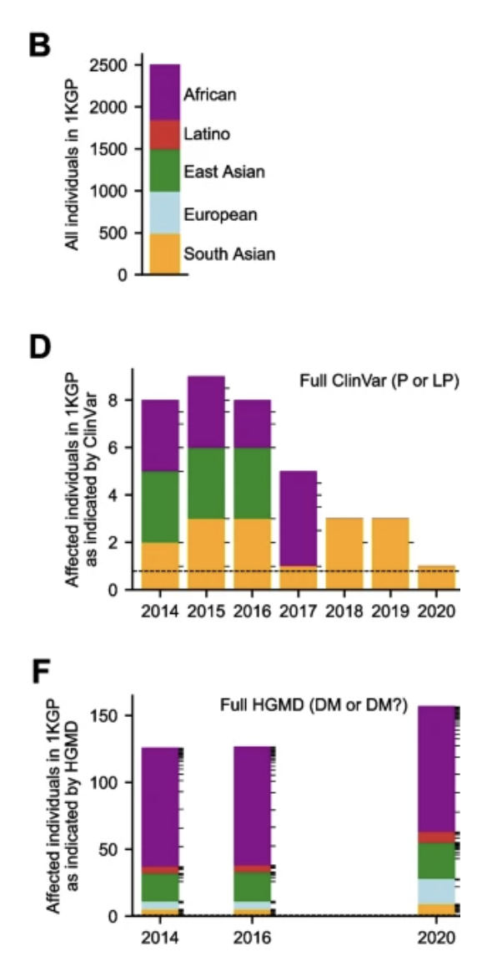
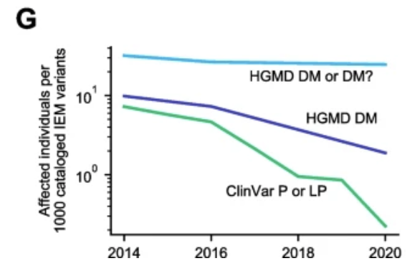
Benign variants Vs. Pathogenic variants
What does population genomics tell us?
Using inborn errors of metabolism (IEMs) screened in newborns as a model system:
These disorders are often highly penetrant with neonatal phenotypes
In population genomics databases, screen for normal individuals with variants classified as pathogenic or likely pathogenic in ClinVar or HGMD
Nearly all such classified pathogenic genotypes indicate likely variant misclassification
Sharo et al., Genome Medicine, 2023; Doi: https://doi.org/10.1186/s13073-023-01199-y

Slide 15
How to determine the pathogenicity of variants?
Given an SNP
Collect all exisiting evidence
Enough evidence => Classification based on certain criteria, such as the ACMG rules
Not enough evidence:
Experiments
Statistical and computational inferrences

Slide 16
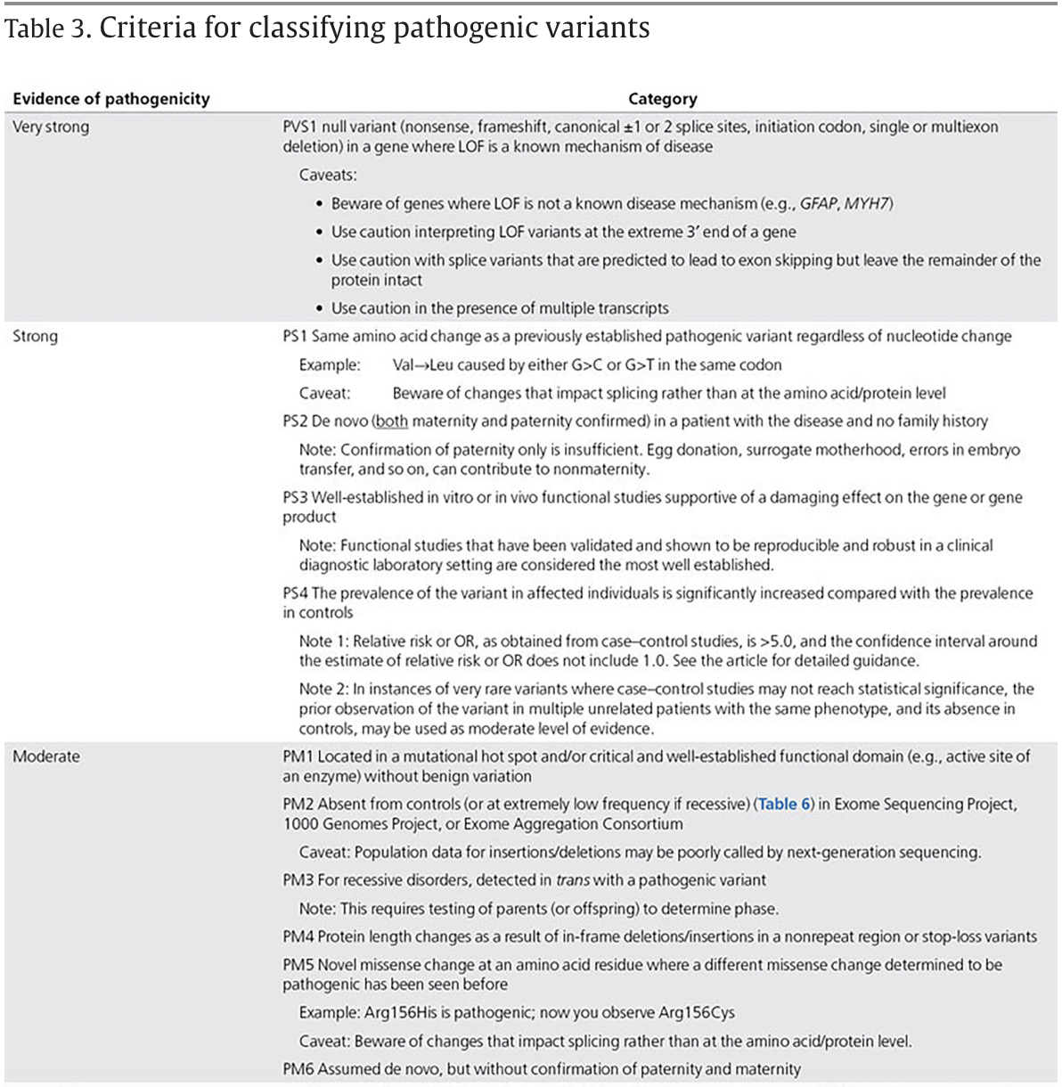
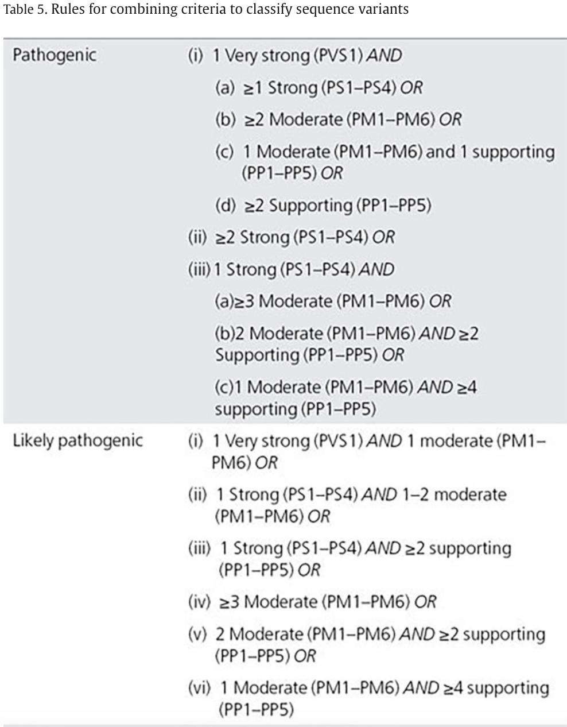
How to determine the pathogenicity of variants?
The ACMG (American College of Medical Genetics and Genomics) rules
Richards et al., Genetics in Medicine, 2015; Doi: https://doi.org/10.1038/gim.2015.30

Slide 17
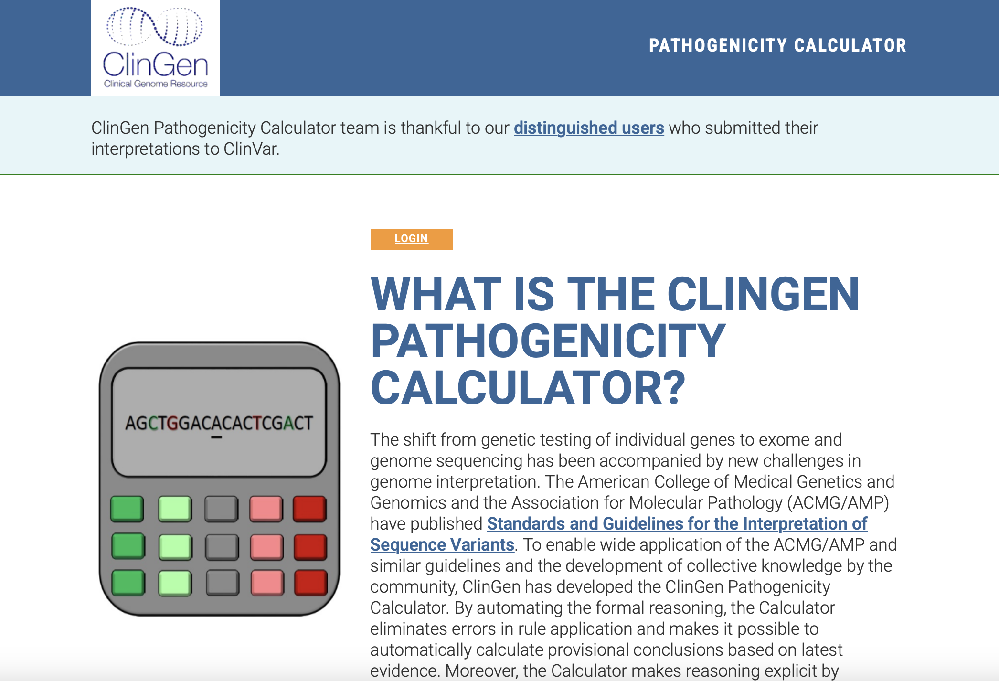
How to determine the pathogenicity of variants?
The automated implementation of the ACMG rules, e.g.:
http://calculator.clinicalgenome.org/site/cg-calculator

Slide 18
How to determine the pathogenicity of variants?
Given an SNP, if without enough existing evidence to classify:
Cellular experiments inc. genome editing
Animal models
Organoid models
Statistically inference
Classic
Machine learning
Deep learning/
Modern AI
Nature’s “experiments”
Logic: human & machine intelligence

Slide 19
How to determine the pathogenicity of variants—statistical procedures
Genome-wide association studies (GWAS)
For common variants
Rare Variant Association Test (RVAT)
For rare variants

Slide 20
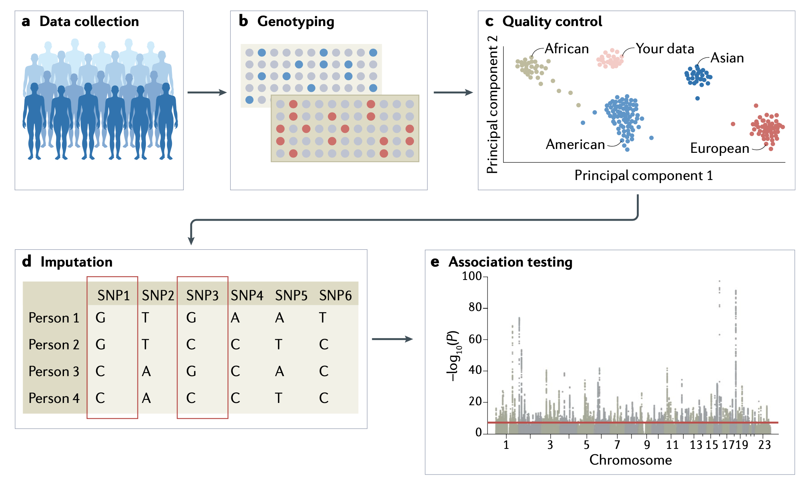
Genome-wide association studies (GWAS): to statistically evaluate the association of an SNP with a trait
Usually based on selected SNP (chips)
Simutaneously testing millions of SNP loci
5e-8 as a commonly adopted genome-wide significance cutoff (5e-2/10^6)
Uffelmann. (2021) Nat Rev Methods Primers. 1:59

Slide 21
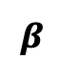
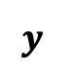
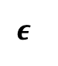
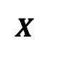
Testing for GWAS Association: Effect Size from an LR Model
$$β$$
$$y$$
$$X$$
$$ε$$
+
=
trait
SNPs
environment +noise
SNP effects

Slide 22
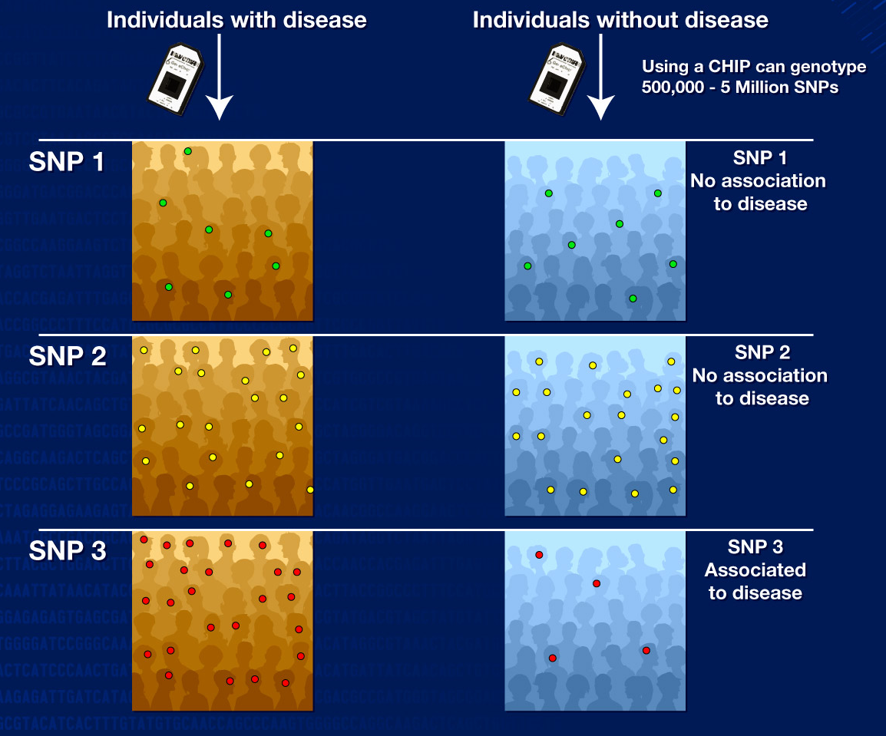
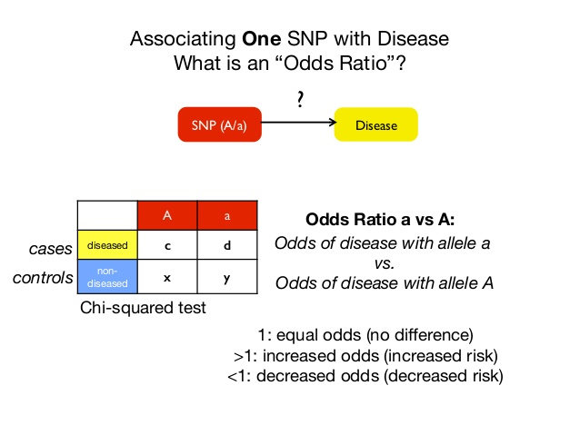
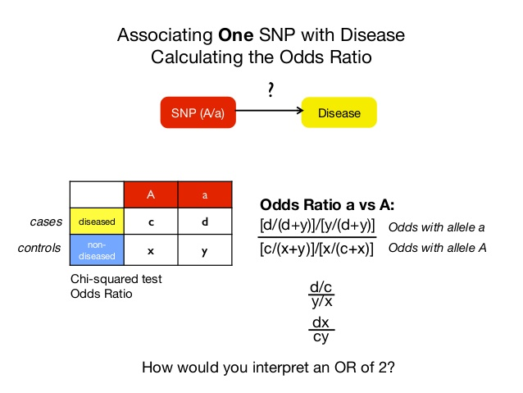
Testing for GWAS Association: Odds Ratio

Slide 23
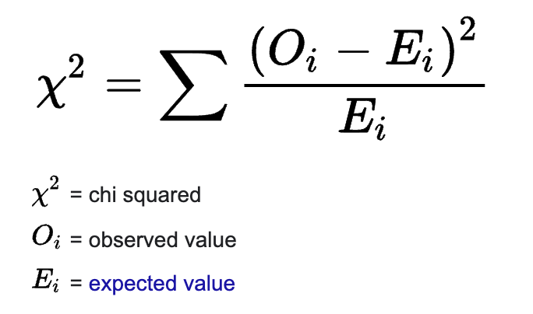
Testing for GWAS Association: Chi-squared Statistic
Observed
rs6767450 | Case | Control | Total
T | 158 | 392 | 550
C | 20 | 86 | 106
Total | 178 | 478 | 656
e.g.,
550*178/656=149.24
Expected
Chi-sq = 4.369
P = 0.037
rs6767450 | Case | Control | Total
T | 149.24 | 400.76 | 550
C | 28.76 | 77.24 | 106
Total | 178 | 478 | 656

Slide 24
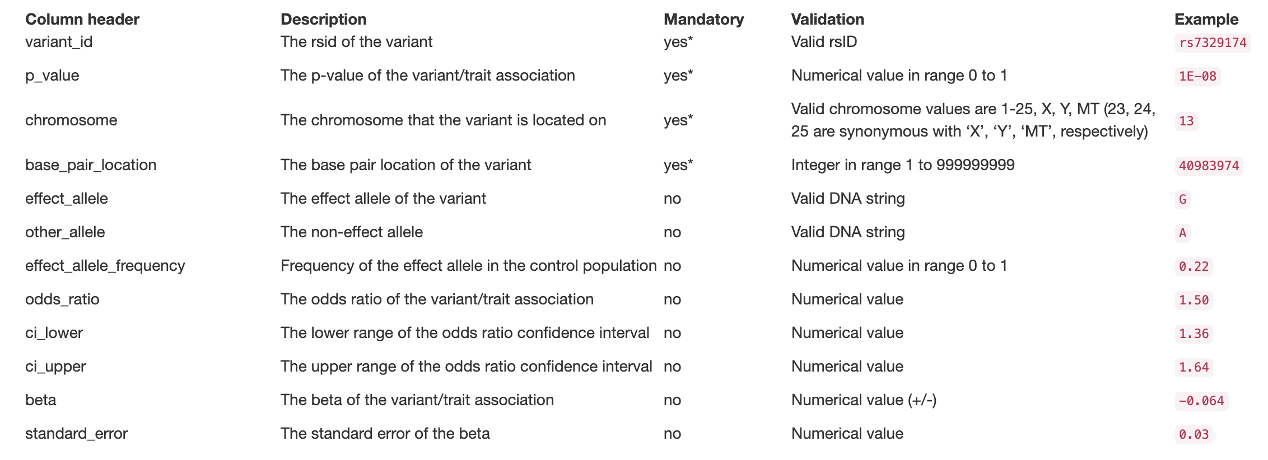
Privacy-preserving Summary Statistics
Summary statistics file format and content

Slide 25
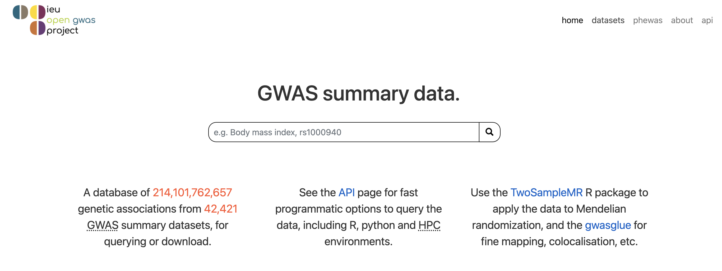
GWAS Summary Statistics Database
https://gwas.mrcieu.ac.uk/

Slide 26
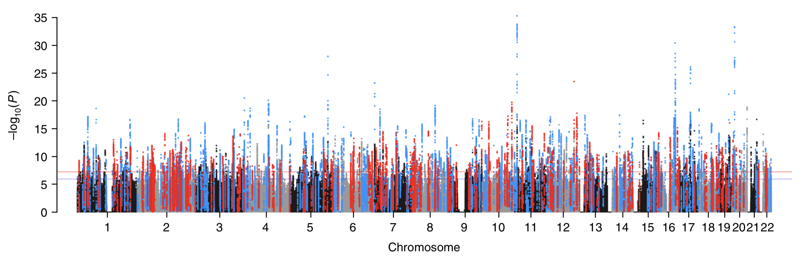
GWAS Catalog: Collection of GWAS Lead SNPs
Manhattan plot
GWAS on blood pressure traits (N = 758K) - Evangelou et al. 2018 Nat Genet
Threshold P=5x10⁻⁸
GWAS Catalog:
Published Genome-Wide Associations at P<5*10⁻⁸
https://www.ebi.ac.uk/gwas/
https://www.ebi.ac.uk/gwas/docs/diagram-downloads

Slide 27
Rare Variant Association Test (RVAT)
Based on exome/genome sequencing
Many more loci collected than SNP chips
Sample size Vs. statistical power
Not limited to SNPs—can test SVs, etc.
Include rare variants
Methods such as
The Sequence Kernel Association Test (SKAT) / SKAT-O (Optimal)
The variant-Set Test for Association using Annotation infoRmation (STAAR)

Slide 28
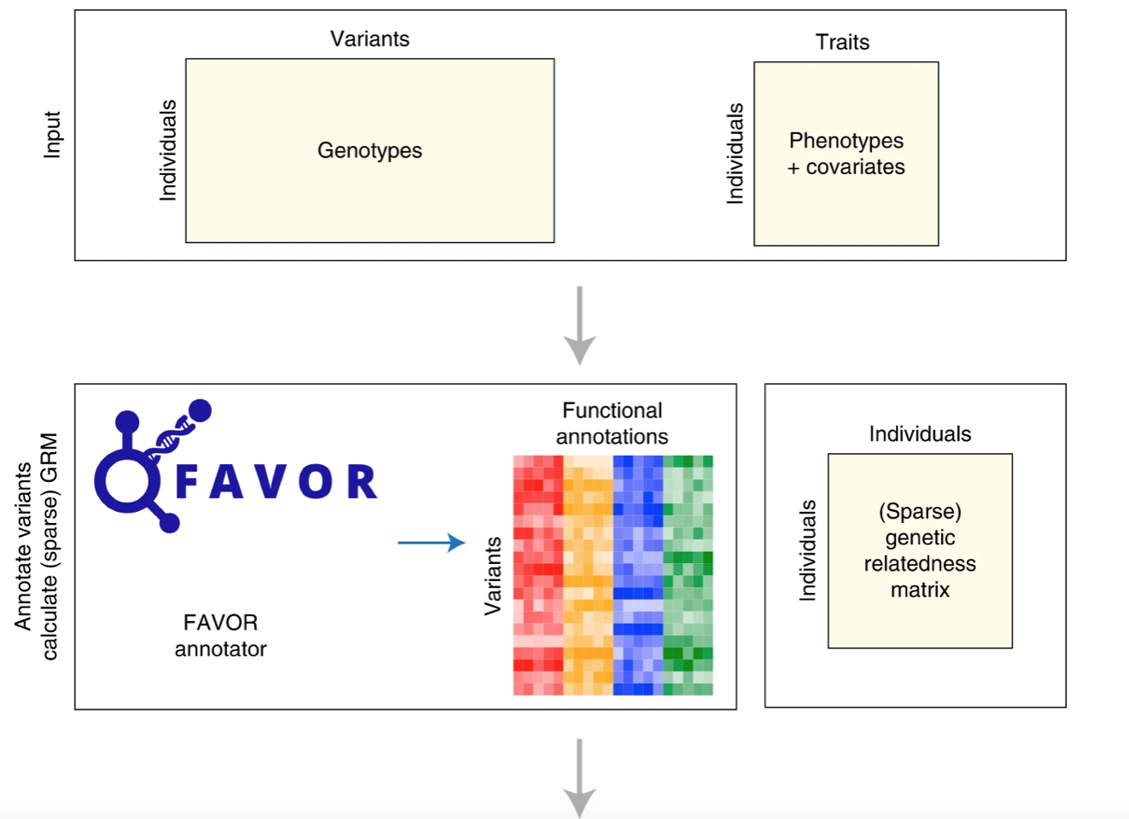
STAAR
Li et al., Nature Methods, 2022; Doi: https://doi.org/10.1038/s41592-022-01640-x

Slide 29
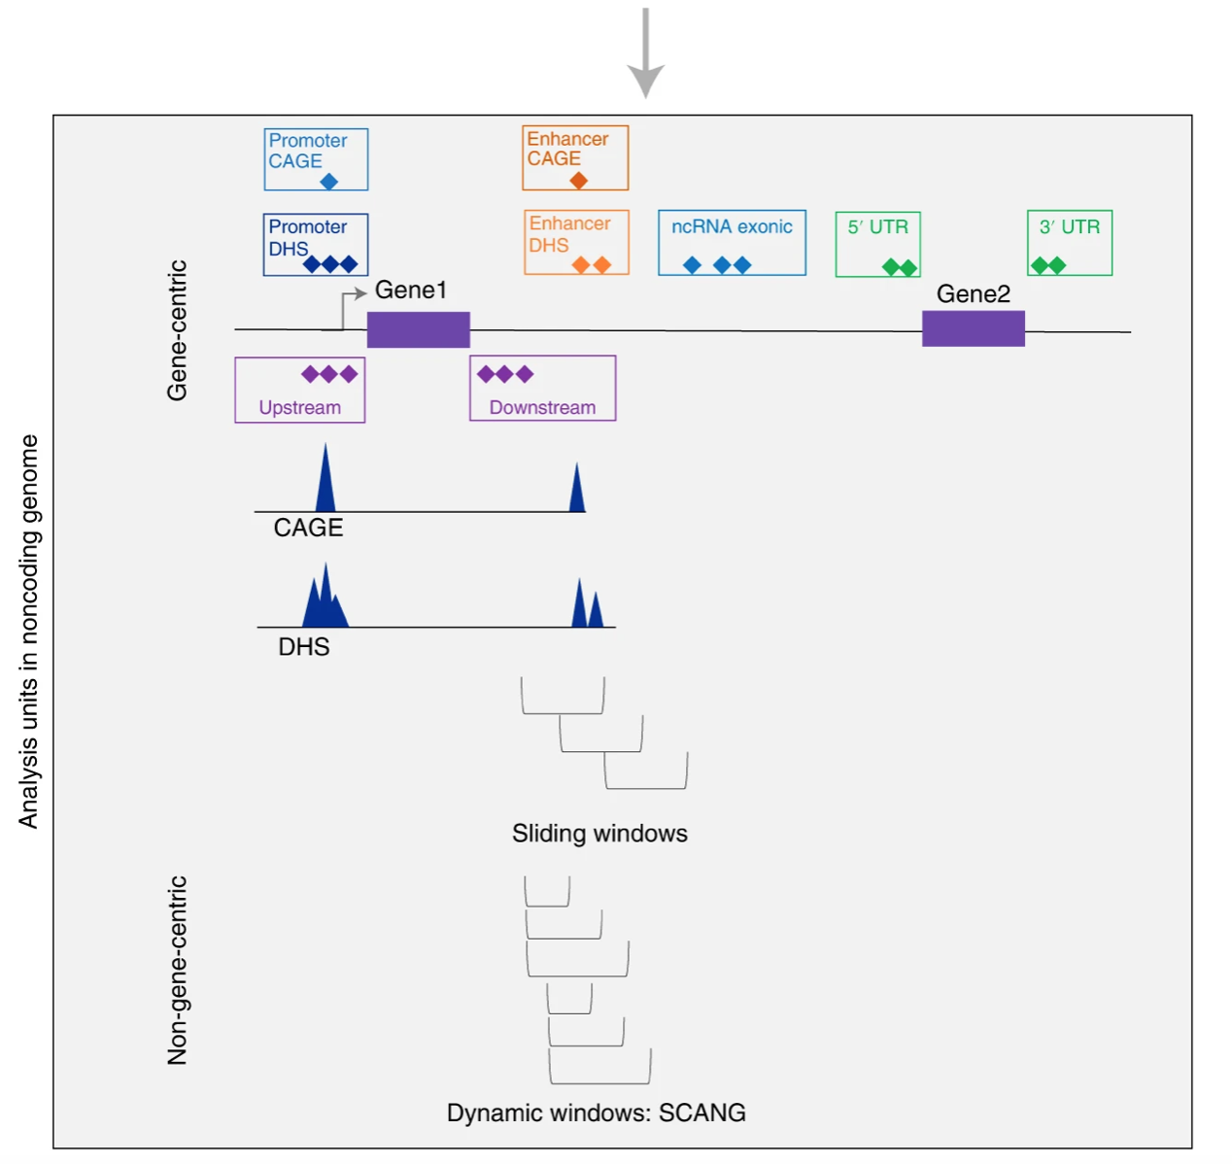
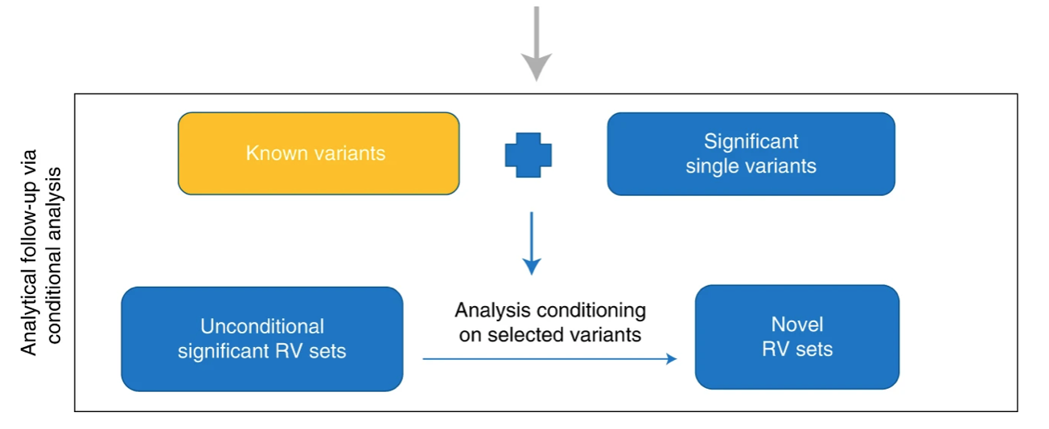
STAAR
Li et al., Nature Methods, 2022; Doi: https://doi.org/10.1038/s41592-022-01640-x

Slide 30
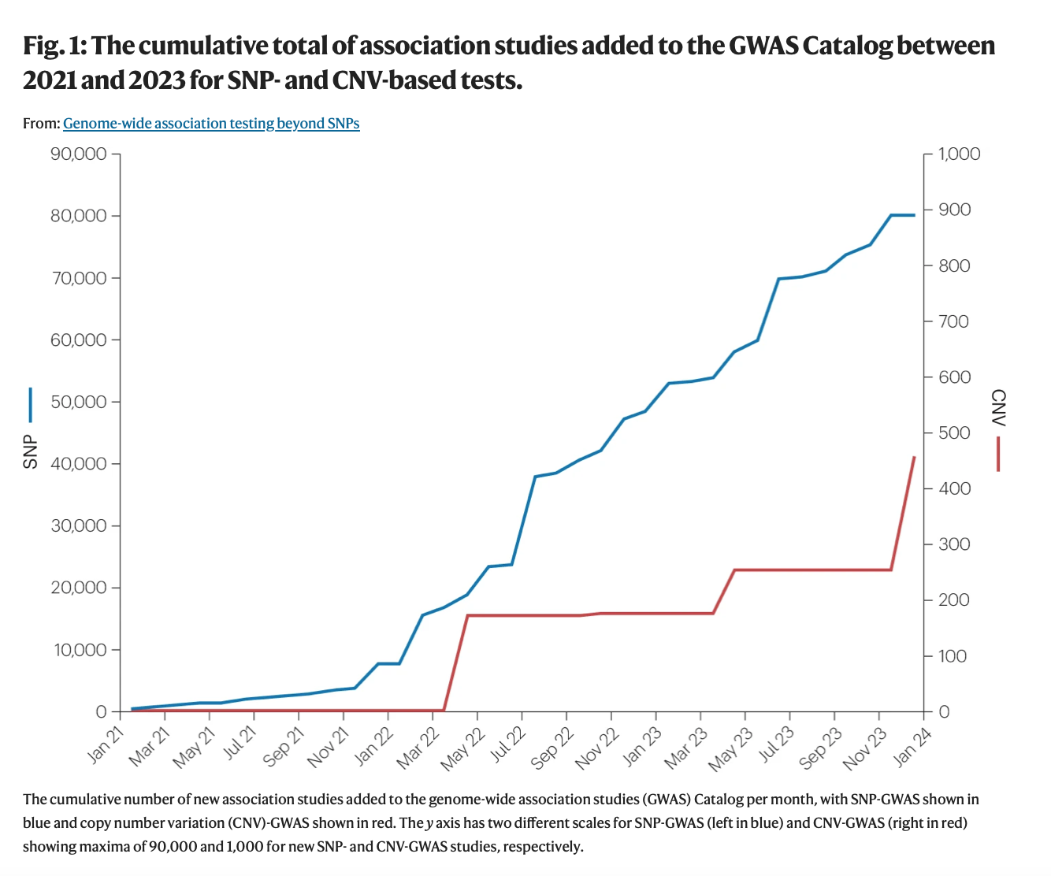
SV GWAS
Similar to SNP GWAS
Fewer SVs per genome than SNPs
Less statistical burden
Harris et al., Nature Reviews Genetics, 2024; Doi: https://doi.org/10.1038/s41576-024-00778-y

Slide 31
How to determine the pathogenicity of variants—machine intelligence based procedures
First step: annotation of variants (features)
Then: various machine learning or heuristic scoring designes

Slide 32
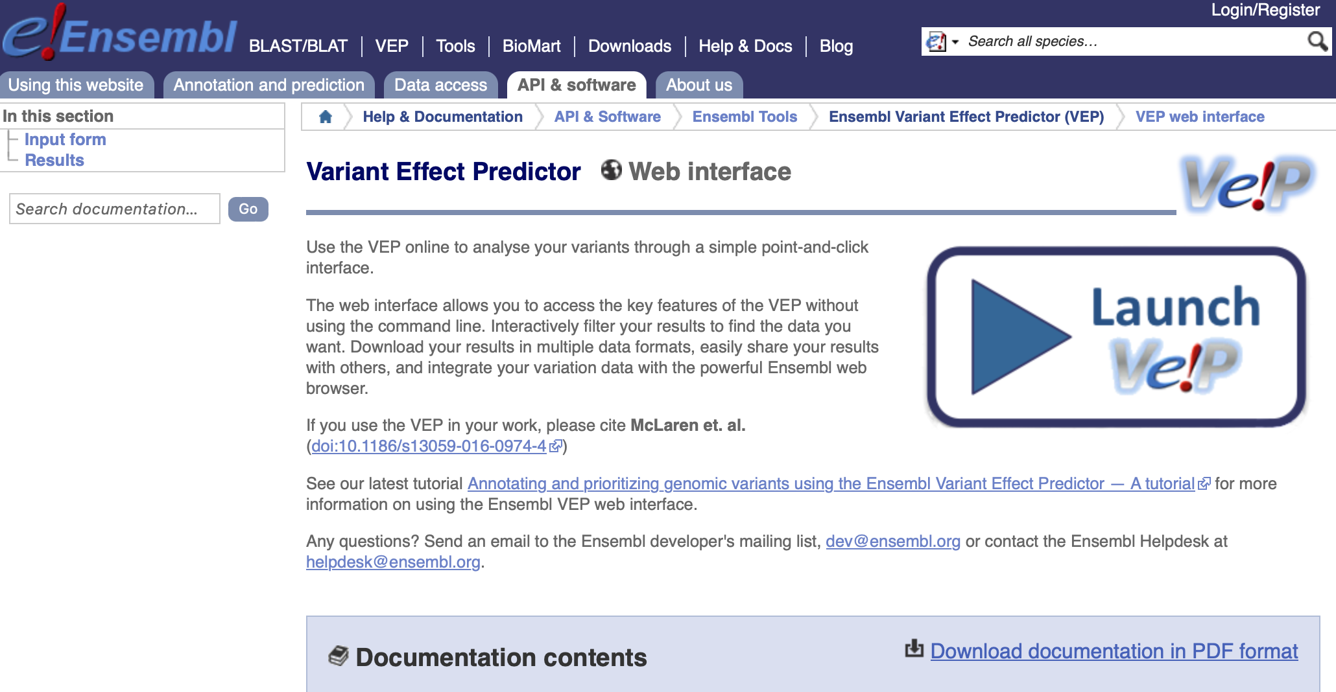
Functional annotation of SNPs/InDels
VEP: http://mart.ensembl.org/info/docs/tools/vep/online/index.html

Slide 33
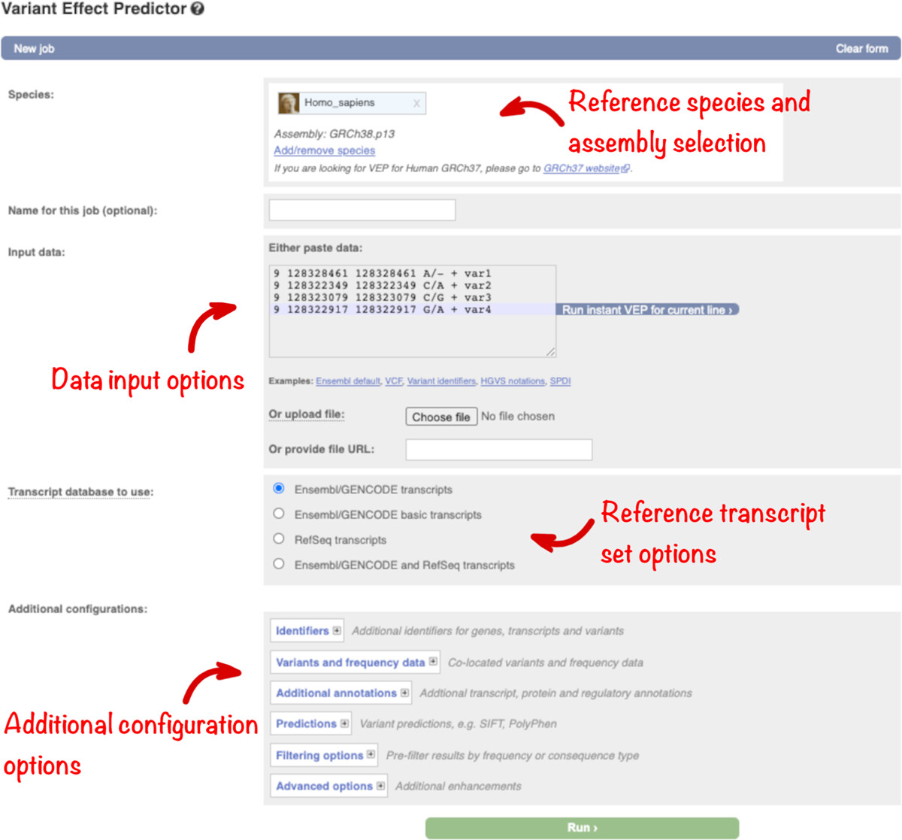
Functional annotation of SNPs/InDels
VEP web interface
Tutorial: https://onlinelibrary.wiley.com/doi/10.1002/humu.24298

Slide 34
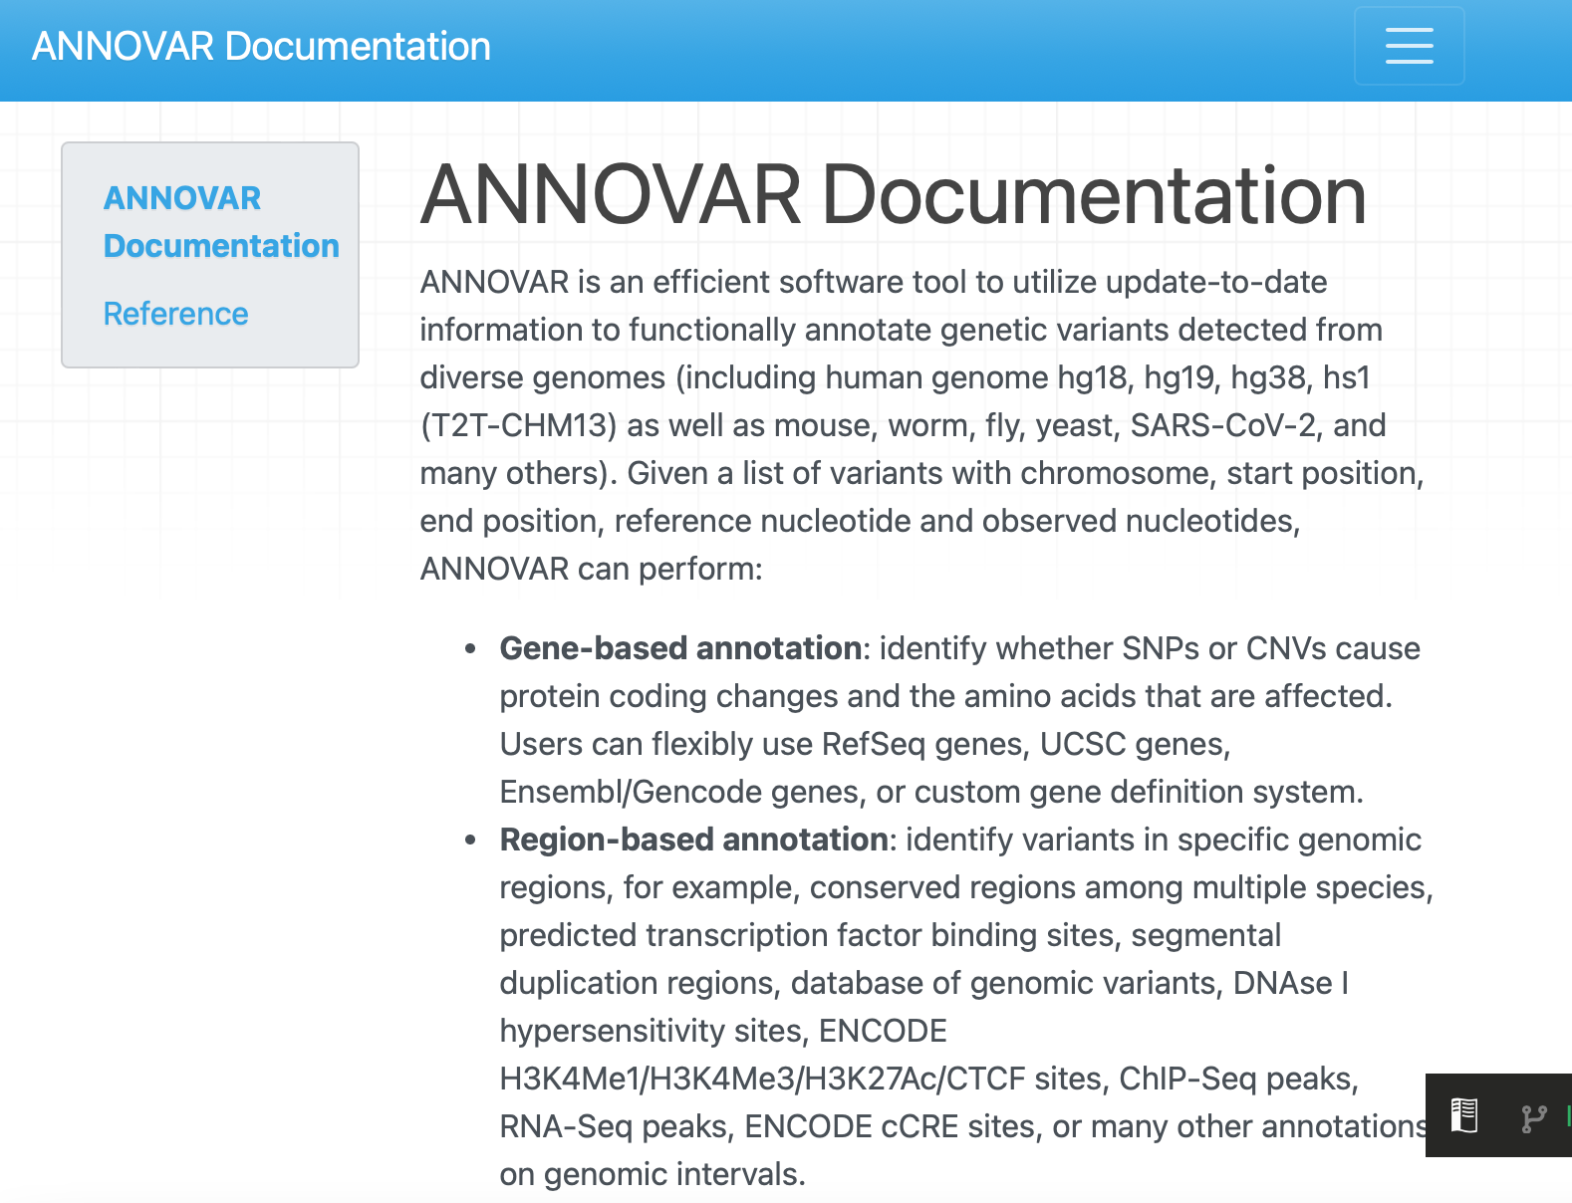
Functional annotation of SNPs/InDels
ANNOVAR: https://annovar.openbioinformatics.org/en/latest/

Slide 35
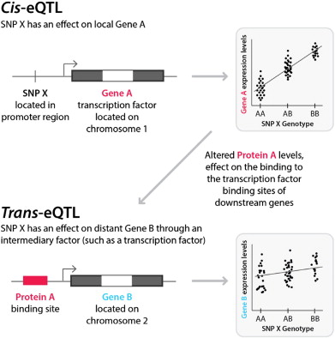
Functional annotation of SNPs/InDels
Regulatory SNPs, quantitative trait loci (QTLs)
eQTL, expression QTL
mQTL, methylation QTL
Etc.
https://www.cnblogs.com/leezx/p/13719620.html

Slide 36
Functional annotation of SNPs/InDels
eQTL databases
The Genotype-Tissue Expression (GTEx) project:
an ongoing effort to build a comprehensive public resource to study tissue-specific gene expression and regulation. Samples were collected from 54 non-diseased tissue sites across nearly 1000 individuals, primarily for molecular assays including WGS, WES, and RNA-Seq. Remaining samples are available from the GTEx Biobank. The GTEx Portal provides open access to data including gene expression, QTLs, and histology images. (https://www.gtexportal.org/home)
eQTLGen
Blood eQTL

Slide 37
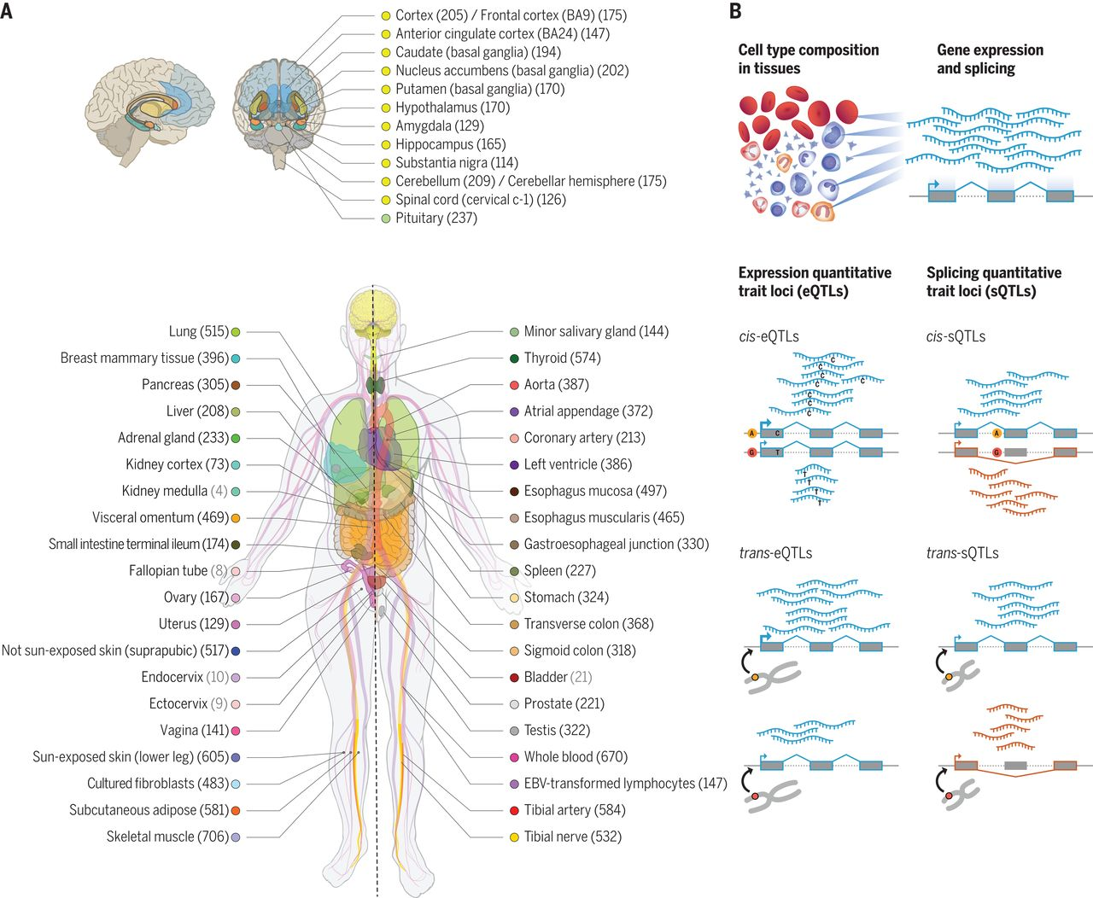
GTEx: covered tissues and cells
https://www.gtexportal.org/home
* GTEx V8 (2020)
THE GTEX CONSORTIUM, Science, 2020; DOI: 10.1126/science.aaz1776

Slide 38
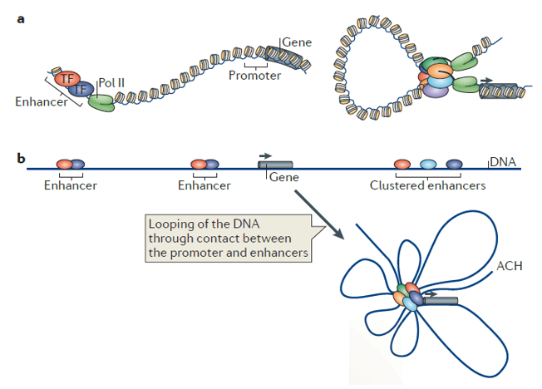
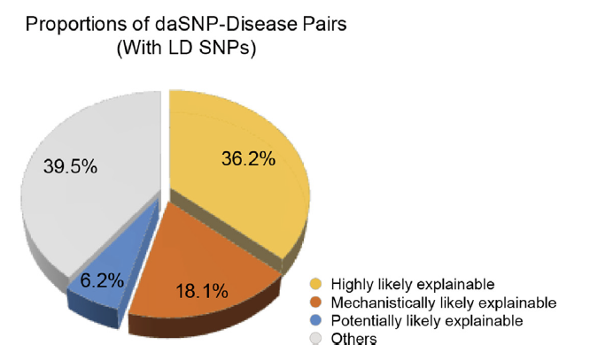
Functional annotation of SNPs/InDels
Regulatory SNPs, enhancer-promoter interactions (EPI)
60% disease-associated
intergenic SNPs are
likely explainable in this way
Long-range regulations can help understand
the contributions of noncoding SNPs to disorders
Nature Reviews Molecular Cell Biology, 2015
Nucleic Acids Research, 2016

Slide 39
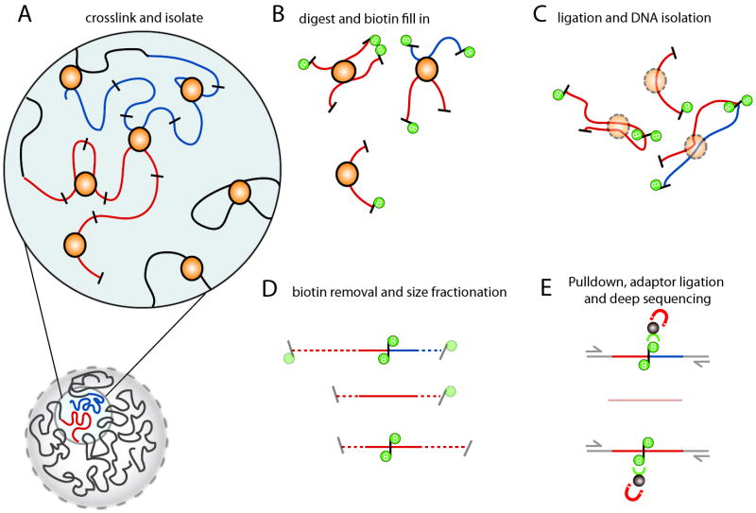
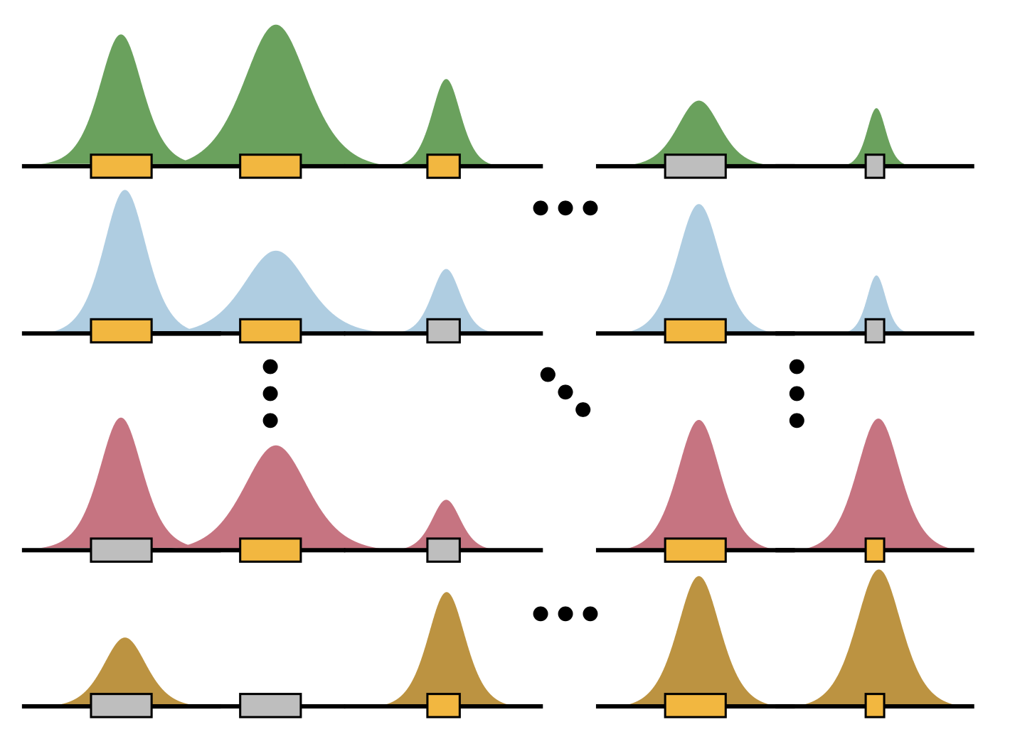
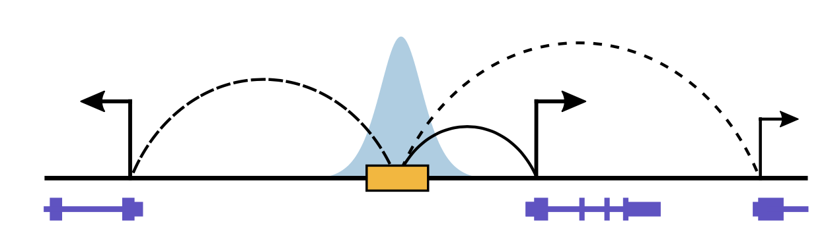
EPI reconstructions
Hi-C: a chromosome conformation capture (3C)-based technology to detect pair-wise chromatin interactions across the whole genome.
Belton et al., Methods, 2012; Doi: 10.1016/j.ymeth.2012.05.001
Reconstructing enhancer-promoter interactions (EPIs)
Computational Approach
in Genomics
Hundreds of cell & tissue types
Slide adapted from Yucheng T. Young

Slide 40
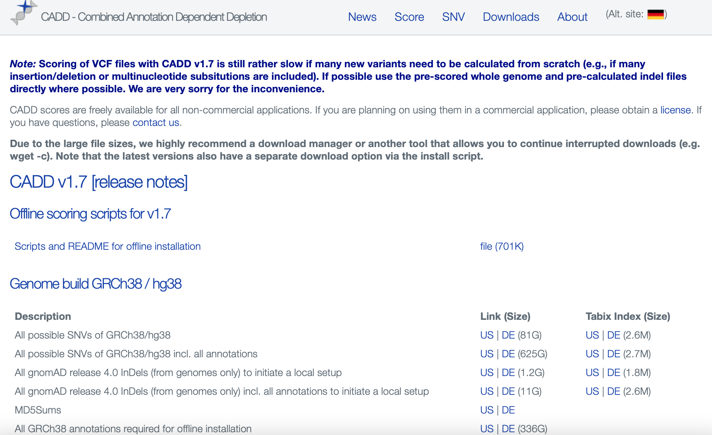
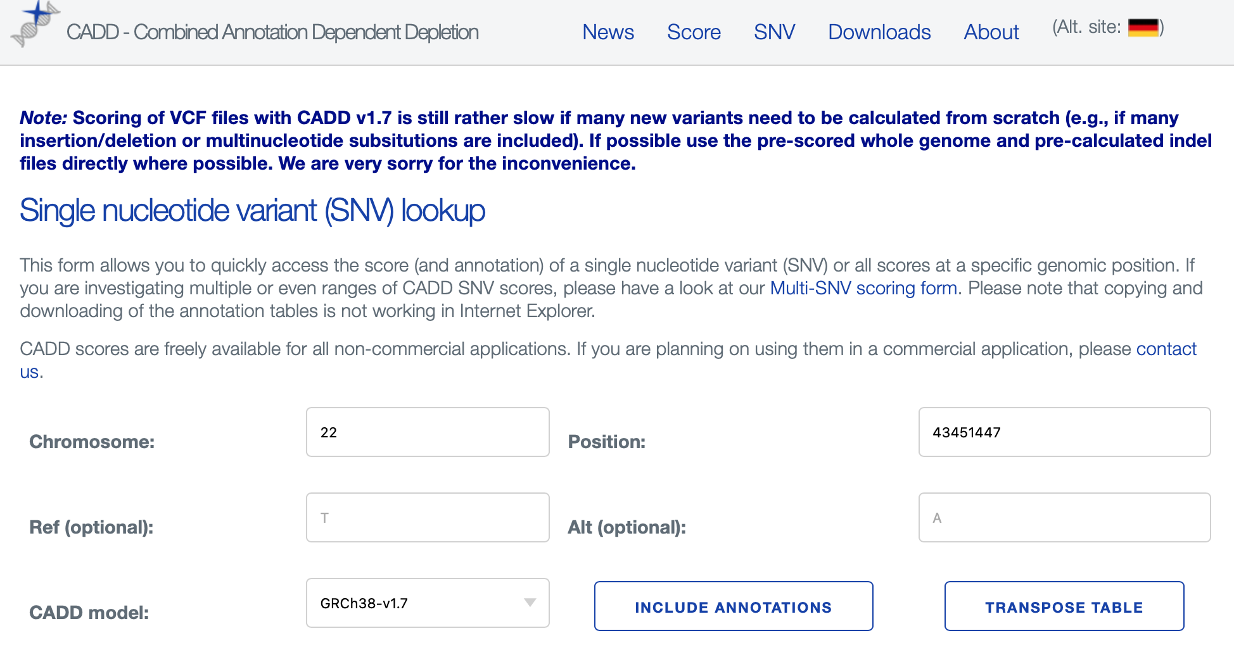
Pathogenicity prediction models of SNPs/InDels
CADD (Combined Annotation Dependent Depletion)
CADD is a tool for scoring the deleteriousness of single nucleotide variants, multi-nucleotide substitutions as well as insertion/deletions variants in the human genome.
Most commonly used in clinical and research settings
Still continue to update after released for many years (the most recent version, v1.7, has incorporated language models and CNN)
https://cadd.gs.washington.edu
Schubach et al., Nucleic Acids Research, 2024; doi: 10.1093/nar/gkad989

Slide 41
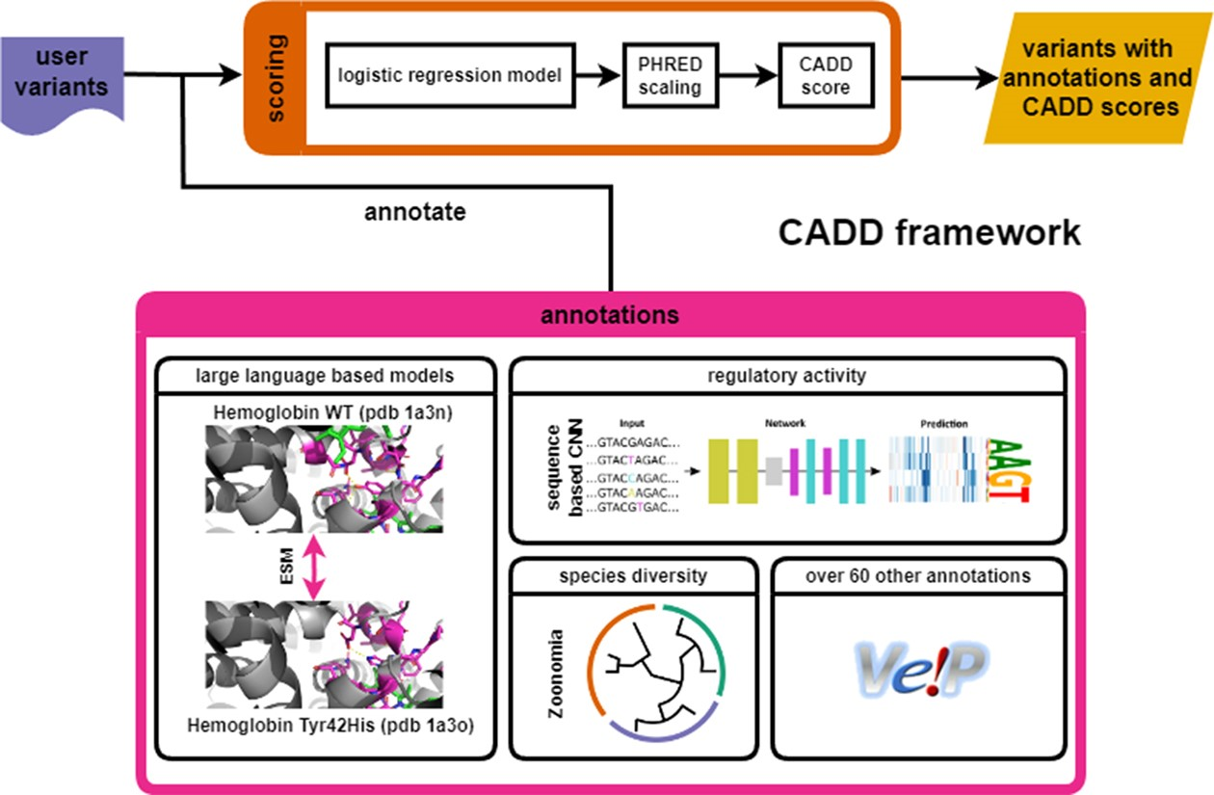
CADD v1.7 framework (2024)
Schubach et al., Nucleic Acids Research, 2024; doi: 10.1093/nar/gkad989

Slide 42
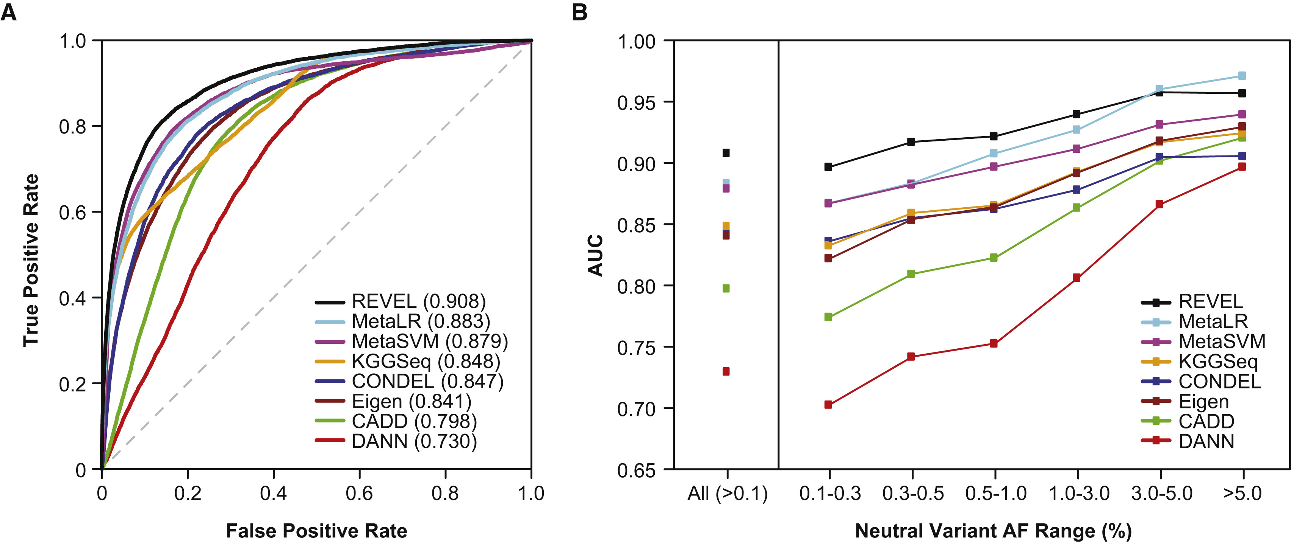
Pathogenicity prediction models of SNPs/InDels
REVEL (Rare Exome Variant Ensemble Learner)
Anensemble method for predicting the pathogenicity of missense variants on the basis of individual tools: MutPred, FATHMM, VEST, PolyPhen, SIFT, PROVEAN, MutationAssessor, MutationTaster, LRT, GERP, SiPhy, phyloP, and phastCons.
Now incorporated in many annotation tools such as VEP
Ioannidis et al., AJHG, 2016; Doi: https://doi.org/10.1016/j.ajhg.2016.08.016

Slide 43
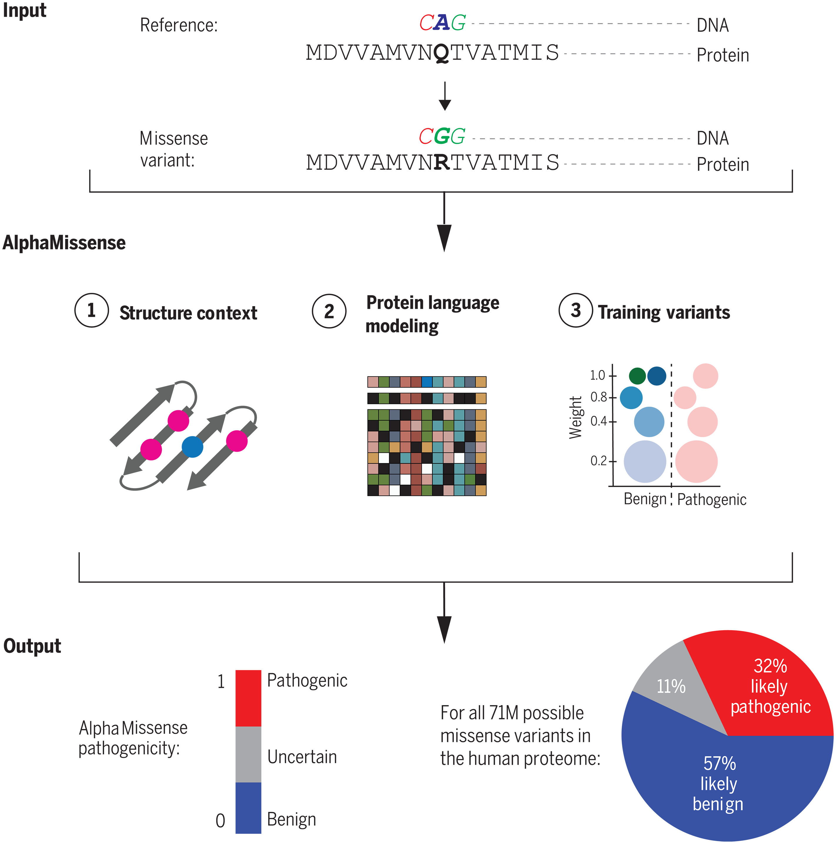
Pathogenicity prediction models of SNPs/InDels
AlphaMissense
Leveraged advances on multiple fronts:
(i) unsupervised protein language modeling to learn amino acid distributions conditioned on sequence context;
(ii) incorporating structural context by using an AlphaFold-derived system;
and (iii) fine-tuning on weak labels from population frequency data, thereby avoiding bias from human-curated annotations
Cheng et al., Science, 2023; DOI: 10.1126/science.adg7

Slide 44
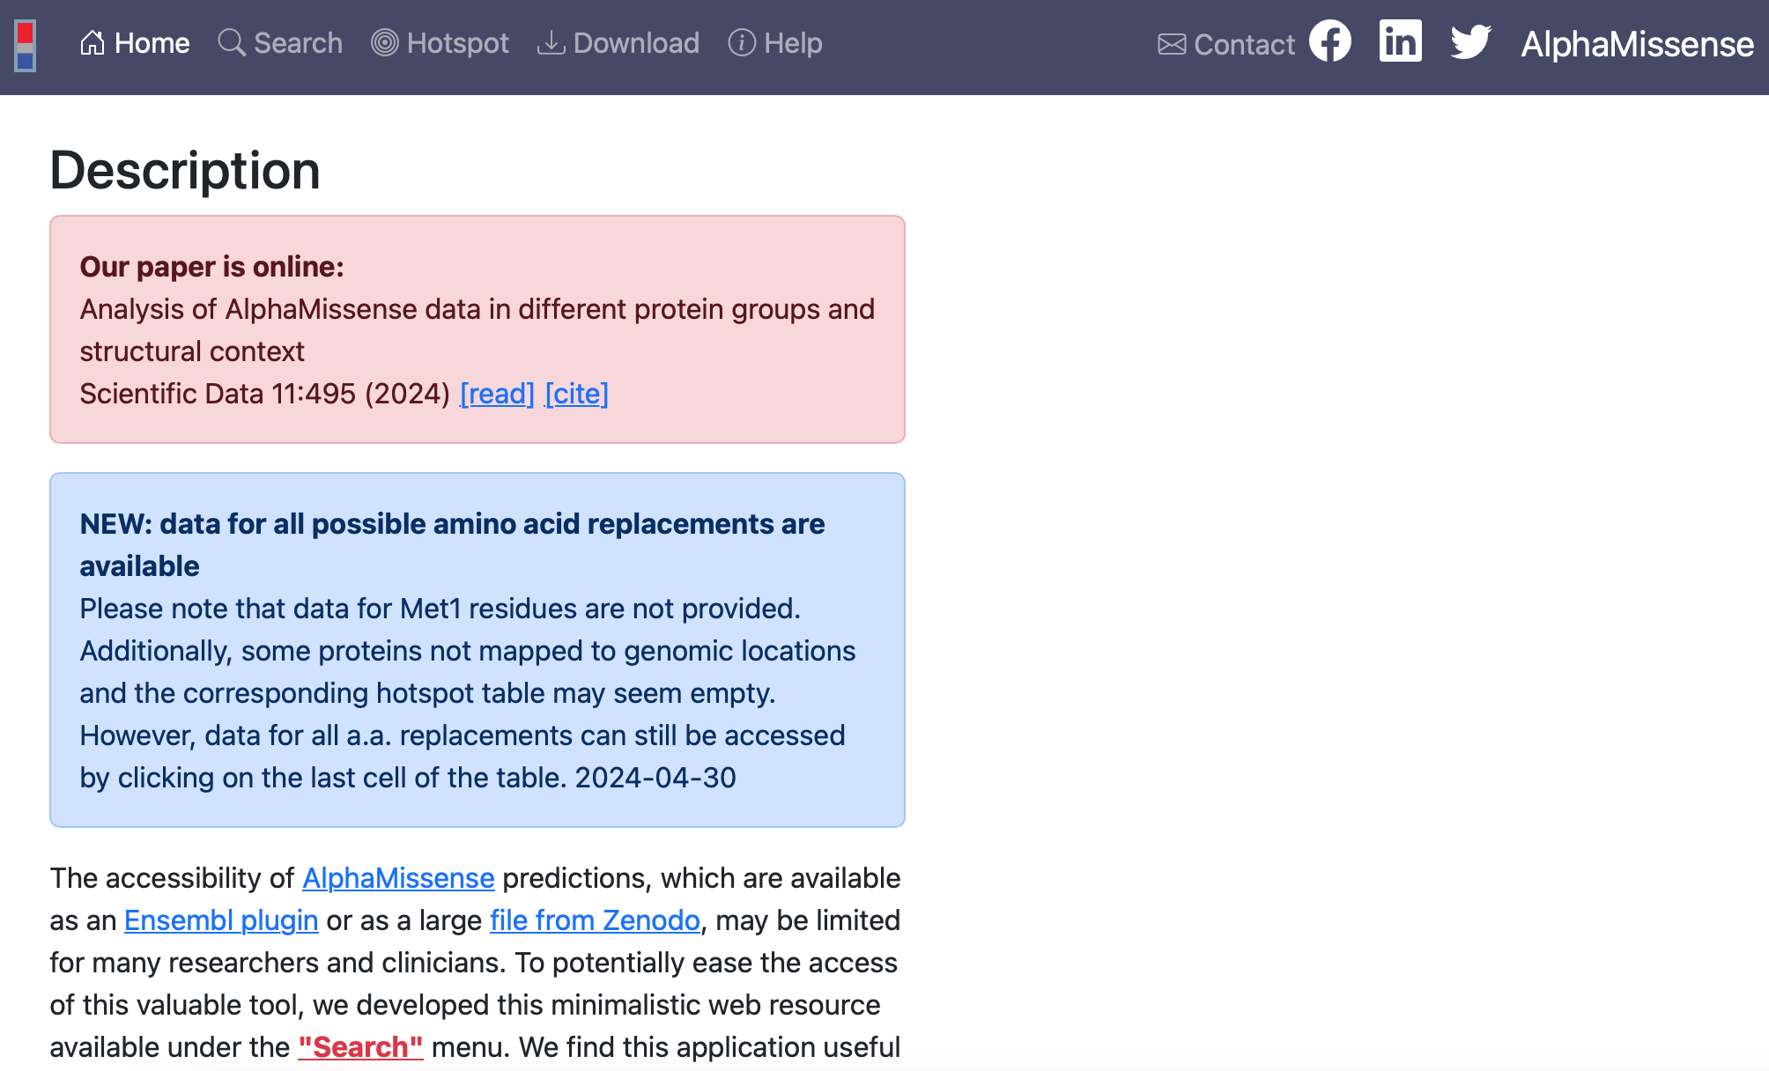
AlphaMissense website
https://alphamissense.hegelab.org

Slide 45
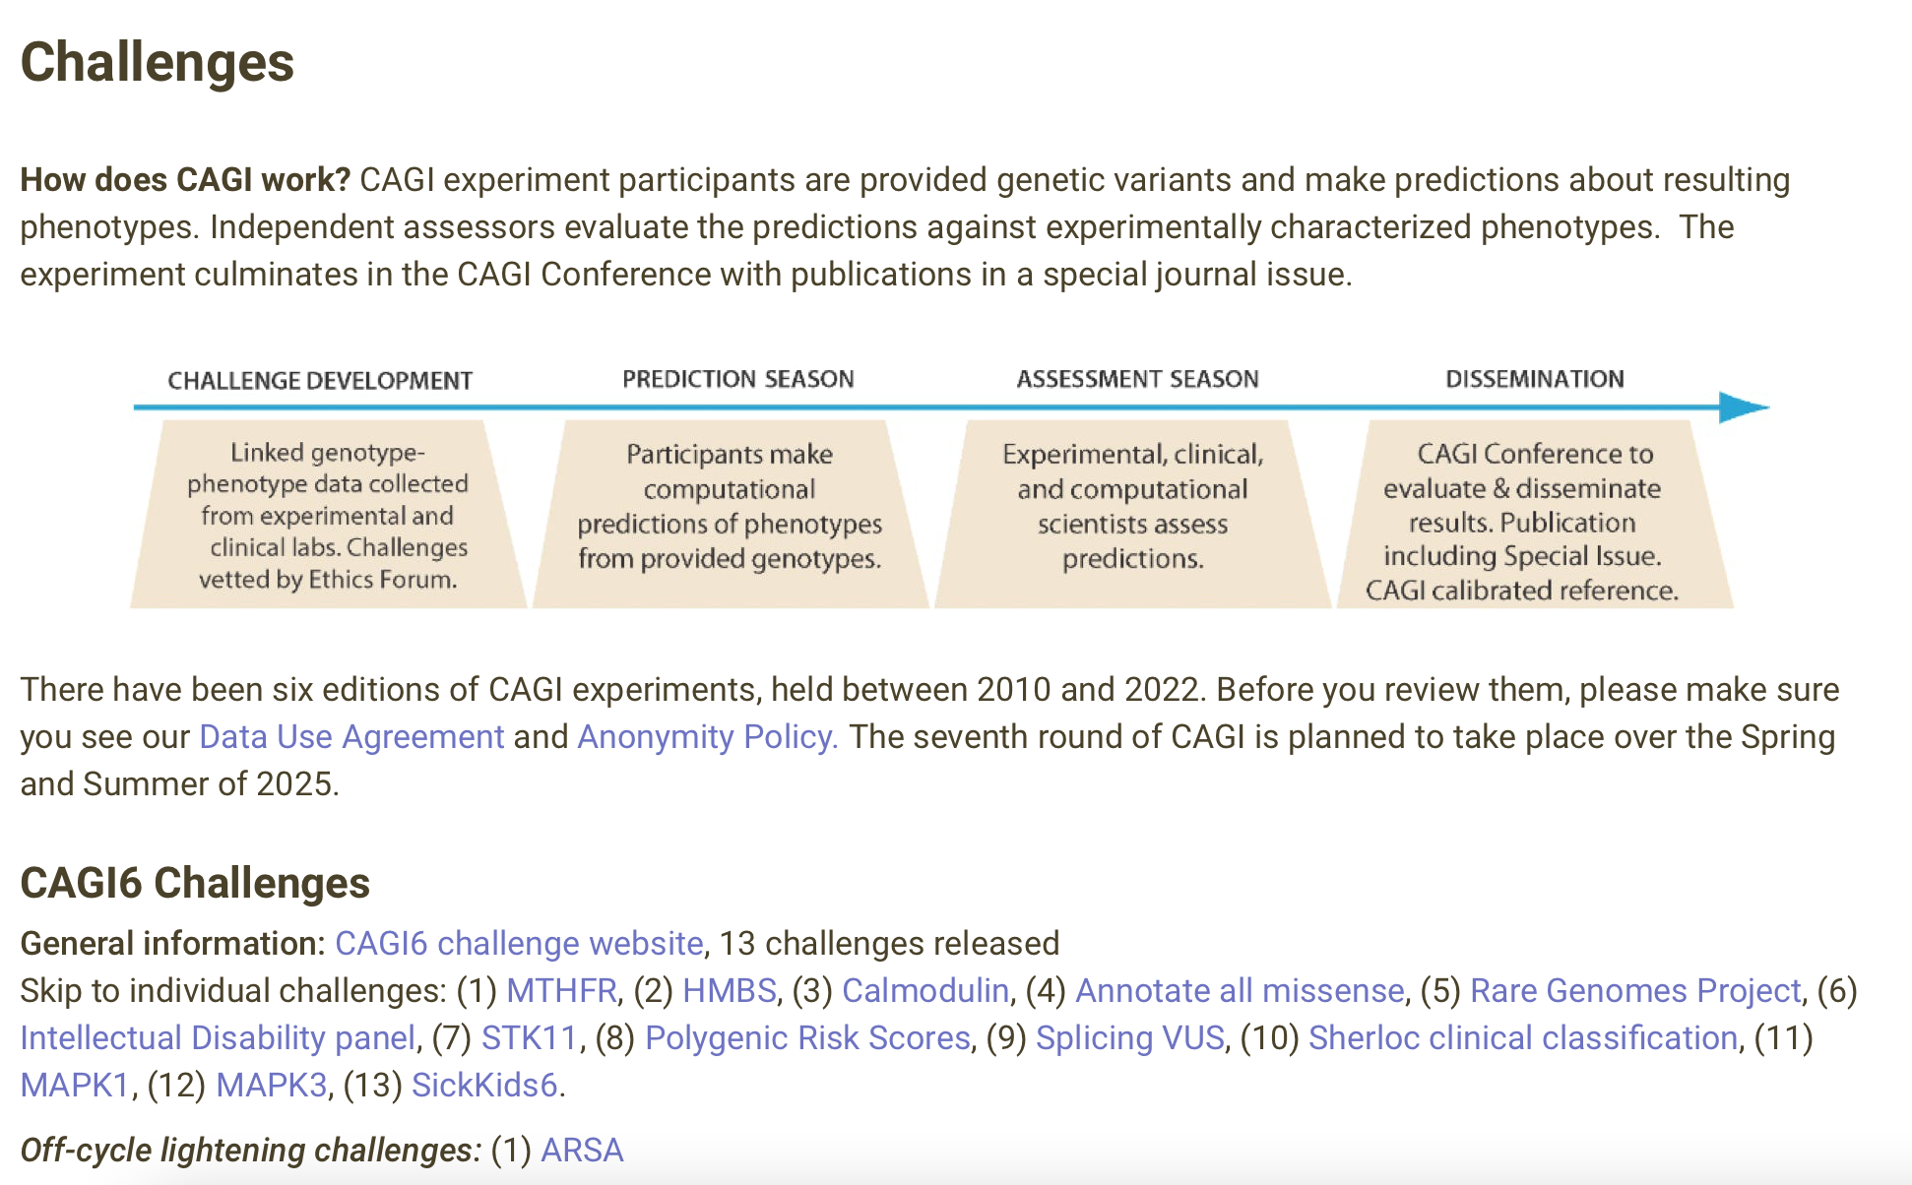
Pathogenicity prediction models of SNPs/InDels
Benchmarking: Critical Assessment of Genome Interpretation (CAGI)
https://genomeinterpretation.org/challenges.html

Slide 46
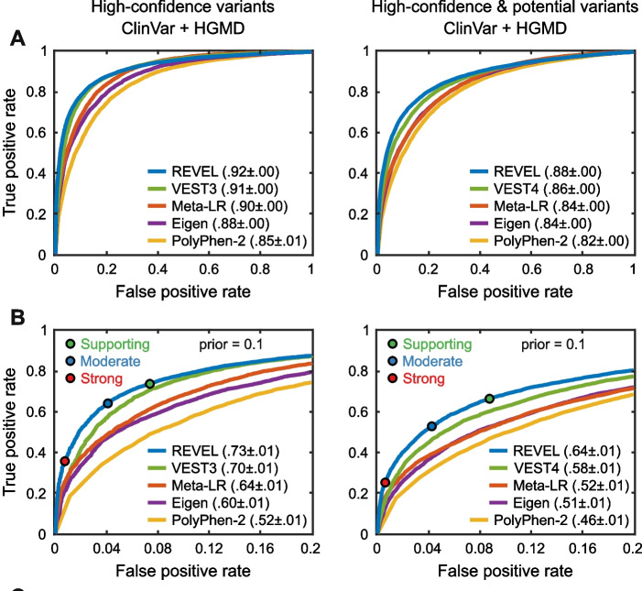
CAGI benchmarking results for identifying pathogenic variants
Critical Assessment of Genome Interpretation Consortium et al., Genome Biology, 2024; Doi: 10.1186/s13059-023-03113-6

Slide 47
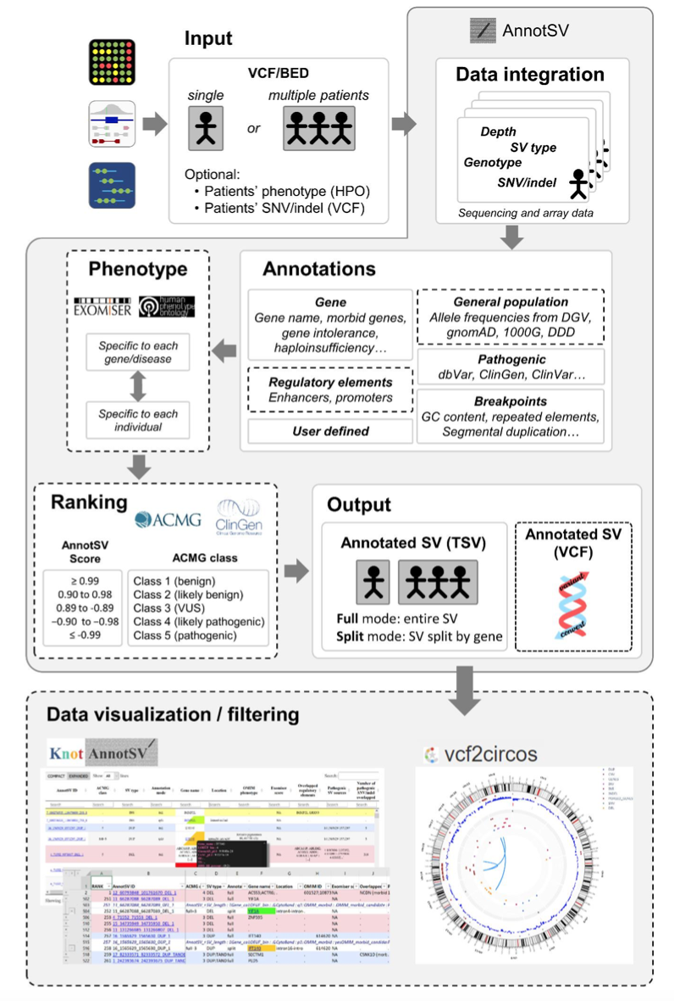

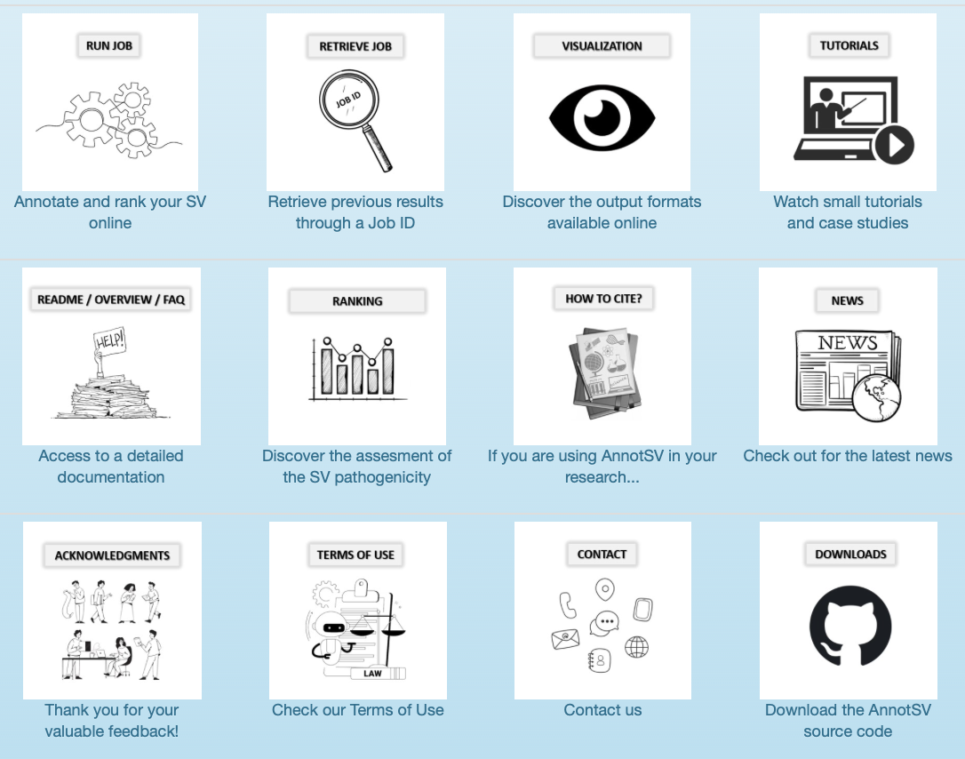
Functional annotation of SVs
https://www.lbgi.fr/AnnotSV/
https://www.lbgi.fr/AnnotSV/
Geoffroy et al., Bioinformatics, 2018; Doi: https://doi.org/10.1093/bioinformatics/bty304

Slide 48
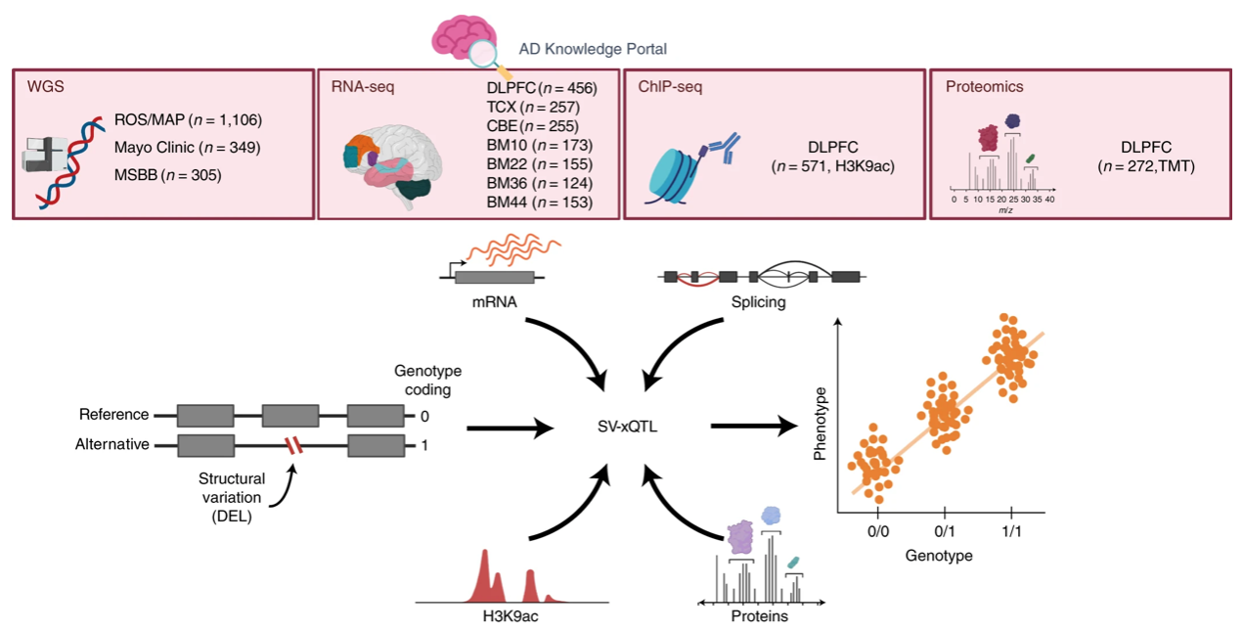
Functional annotation of SVs
SV-xQTLs, identified by multiple studies, for example:
Vialle et al., Nature Neuroscience, 2022; Doi: https://doi.org/10.1038/s41593-022-01031-7

Slide 49


Pathogenicity prediction of SVs
StrVCTVRE: designed for SVs that overlap exons
A random forest classifier
Feature importance
Performance
Sharo et al., AJHG, 2022; Doi: 10.1016/j.ajhg.2021.12.007

Slide 50

Pathogenicity prediction models of SVs
SVFX
“We present a mechanism-agnostic machine learning-based workflow, called SVFX, to assign pathogenicity scores to somatic and germline SVs. In particular, we generate somatic and germline training models, which include genomic, epigenomic, and conservation-based features, for SV call sets in diseased and healthy individuals. We then apply SVFX to SVs in cancer and other diseases; SVFX achieves high accuracy in identifying pathogenic SVs. Predicted pathogenic SVs in cancer cohorts are enriched among known cancer genes and many cancer-related pathways.”
Kumar et al., Genome Biology, 2020; Doi: https://doi.org/10.1186/s13059-020-02178-x

Slide 51

Pathogenicity prediction models of SVs
DeepSVP
“We developed DeepSVP, a computational method to prioritize structural variants involved in genetic diseases by combining genomic and gene functions information. We incorporate phenotypes linked to genes, functions of gene products, gene expression in individual cell types and anatomical sites of expression, and systematically relate them to their phenotypic consequences through ontologies and machine learning. DeepSVP significantly improves the success rate of finding causative variants in several benchmarks and can identify novel pathogenic structural variants in consanguineous families.”
Althagafi et al., Bioinformatics, 2021; Doi: 10.1093/bioinformatics/btab859

Slide 52
Validation of potentially pathogenic variants
By outside evidence
(1) Repeat the same procedure in outside datasets, or meta-analysis of many datasets
(2) Identified by other reliable works as pathogenic variants, or there are identified pathogenic variants in the same location

Slide 53
Validation of potentially pathogenic variants
By functional experiments
Reporter essays in appropriate cells
Genome editing (e.g. CRISPR) of relevant cells
By animal models
Such as mouse or money
By organoid models
Many different organs now have organoid models

Slide 54
In summary, what can we learn for a given variant?
Statistical inference, from case Vs contorl comparisons
Functional annotation
Pathogenicity prediction
Computational or experimental validations of the potential functional impact

Slide 55
Example studies for determining pathogenic variants
With the development of sequencing technologies and accumulation of data, many cohort-based studies have emerged in the past few years, to determine pathogenic variants for various disorders
Here, a few examples based on exome or genome sequencing will be presented

Slide 56

(1) Exome-based newborn screening for metabolic disorders
The motivation:
Adhikari et al., Nature Medicine, 2020; Doi: https://doi.org/10.1038/s41591-020-0966-5

Slide 57

(1) Exome-based newborn screening for metabolic disorders
The design:
Adhikari et al., Nature Medicine, 2020; Doi: https://doi.org/10.1038/s41591-020-0966-5

Slide 58

(2) Exome-based genome-wide association study for Alzheimer’s disease
Exome sequencing identifies rare damaging variants in ATP8B4 and ABCA1 as risk factors for Alzheimer's disease
Holstege et al., Nature Genetics, 2022; Doi: 10.1038/s41588-022-01208-7

Slide 59
How to build your own pipeline?
Things to consider?
From study design to pathogenic variants identification
Please review the last three classes, and then design a study framework for determining common and rare SVs contributing to Schizophrenia based on a Chinese cohort of 2000 people (1000 case Vs. 1000 control). Please state in details what you need to consider in every step.
Homework!

Slide 60
Summary
Benign & pathogenic variants: databases, evidences
How to determine the pathogenicity of variants
Example studies

